Slide 1

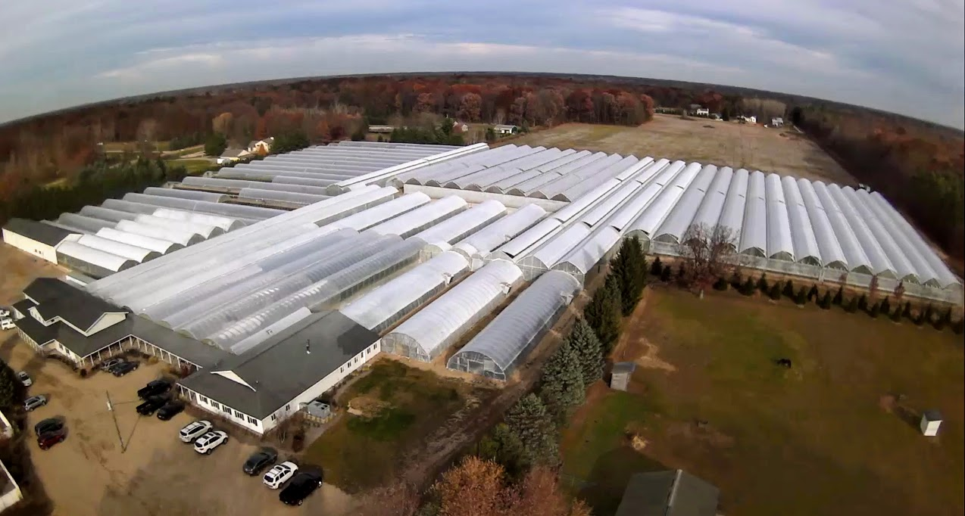
GROWING IN OVER 15 ACRES OF covered GREENHOUSE space

Slide 2
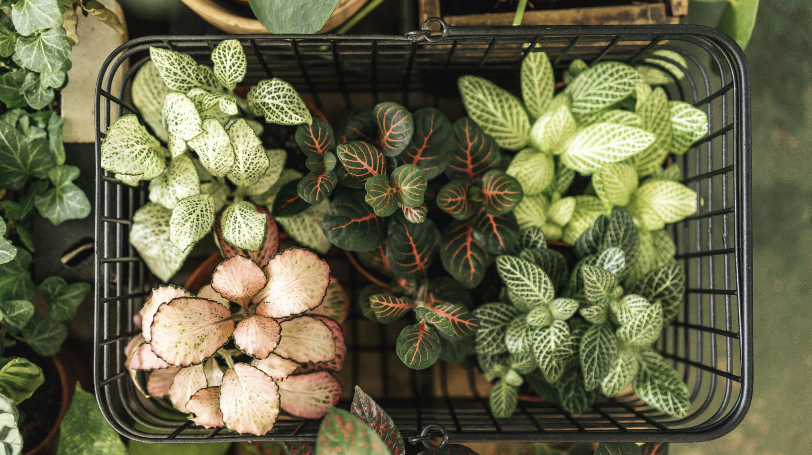
Why Opel Growers?
Family Owned
Dedicated to Independent Garden Centers with no Box Store sales.
Large selection of Plant Categories of perennials, annuals, groundcover, herbs, vegetables, house plants in multiple sizes, making the need to bring in multiple suppliers and multiple trucks in a week down to a minimum.
Within each category a large selection of variety giving your customers many more options not available at Box Stores.
Everything comes with tags and a barcode to accommodate any POS system.
Most of the perennial line comes with SKU’s down to the variety and size so you know exactly what you are selling!
Easy rolling carts for all employees to handle.
Great Customer Service.
Knowledgeable staff

Slide 3
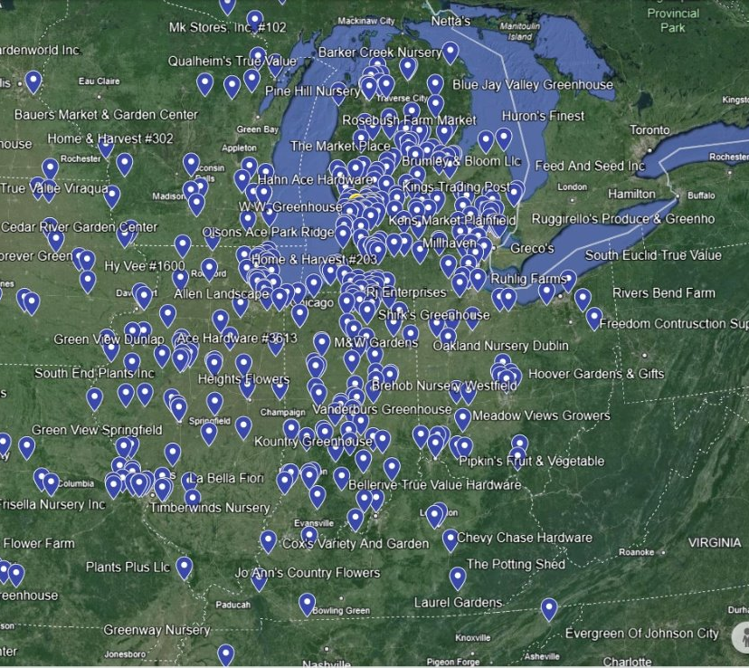

Our Footprint in the Midwest

Slide 4
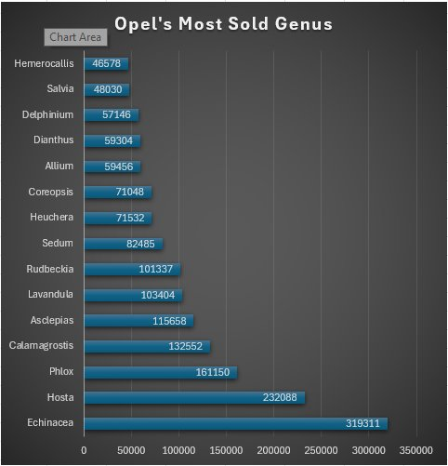
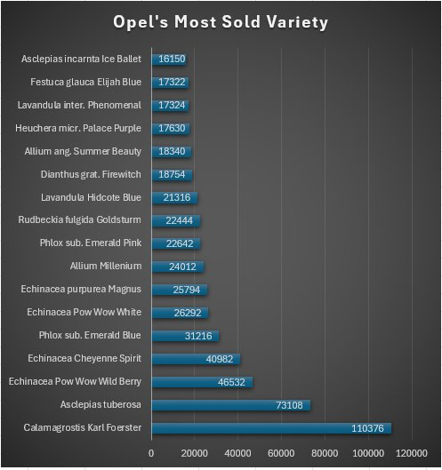

Slide 5

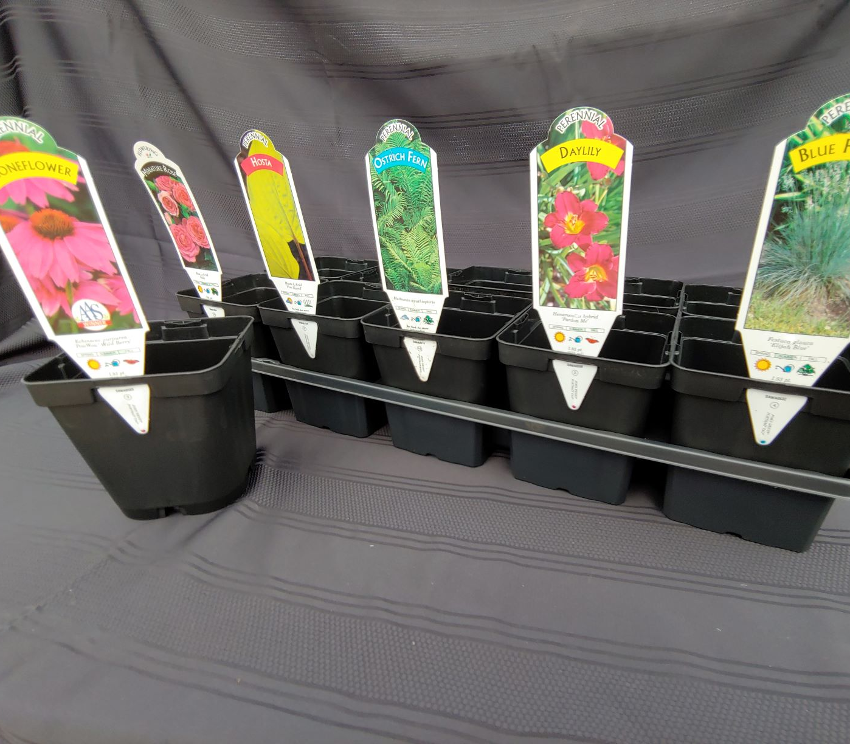
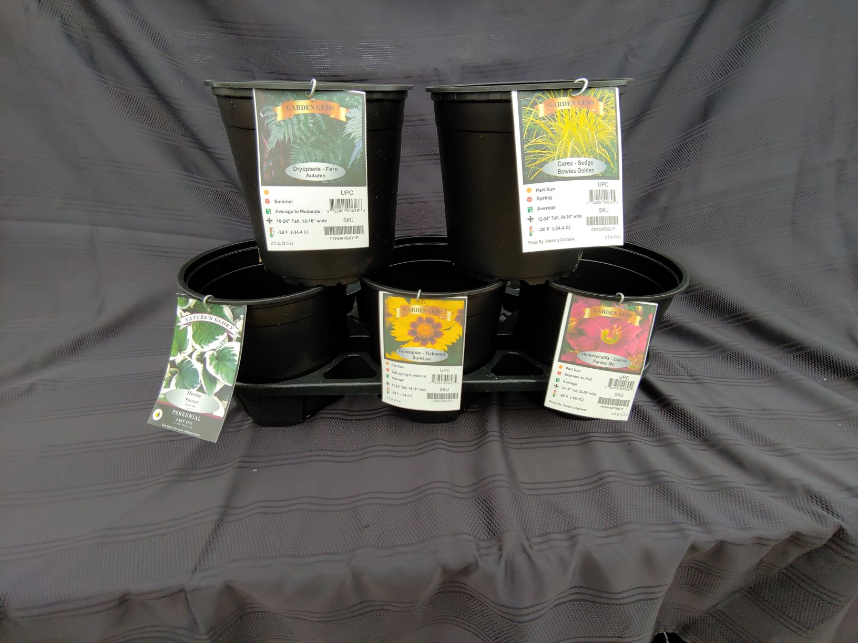
Quality perennials in both the #1pot (2.5 qt.) and in our 4.5in (1qt.) pot.

Slide 6
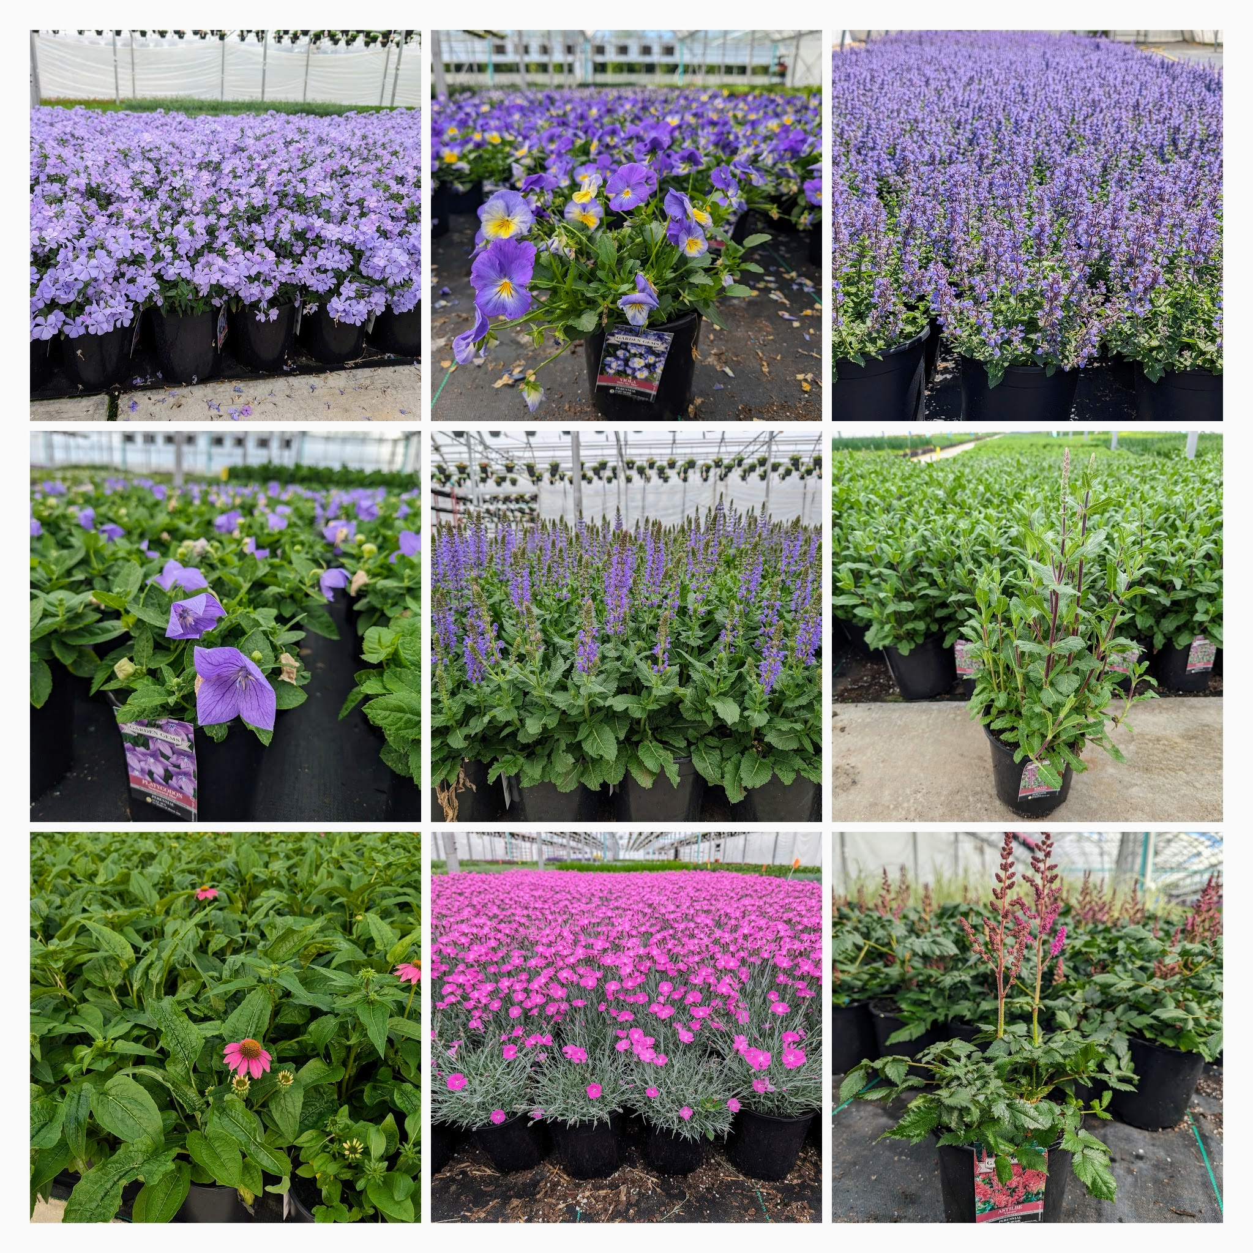
Over 400 different varieties in our Garden Gem line!

Slide 7
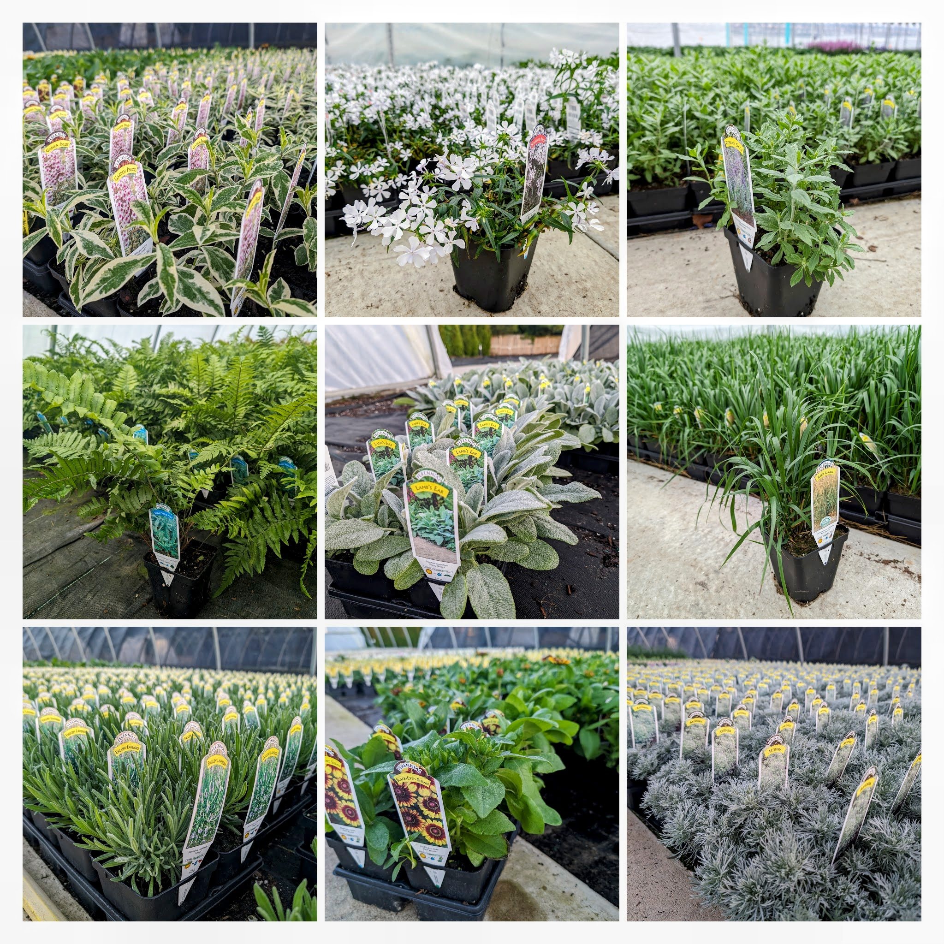
4.5 in. Qt. Perennials

Slide 8
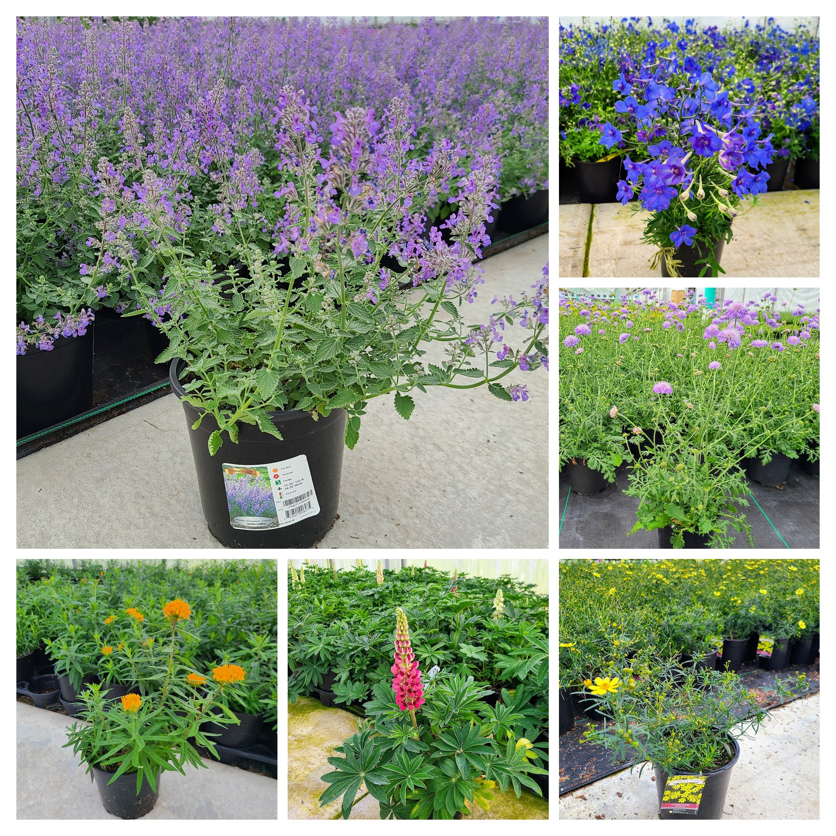
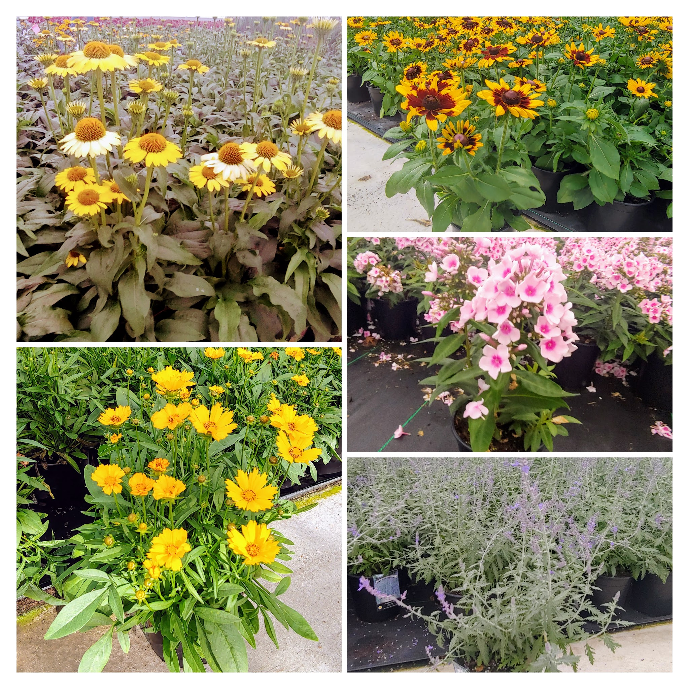

Slide 9
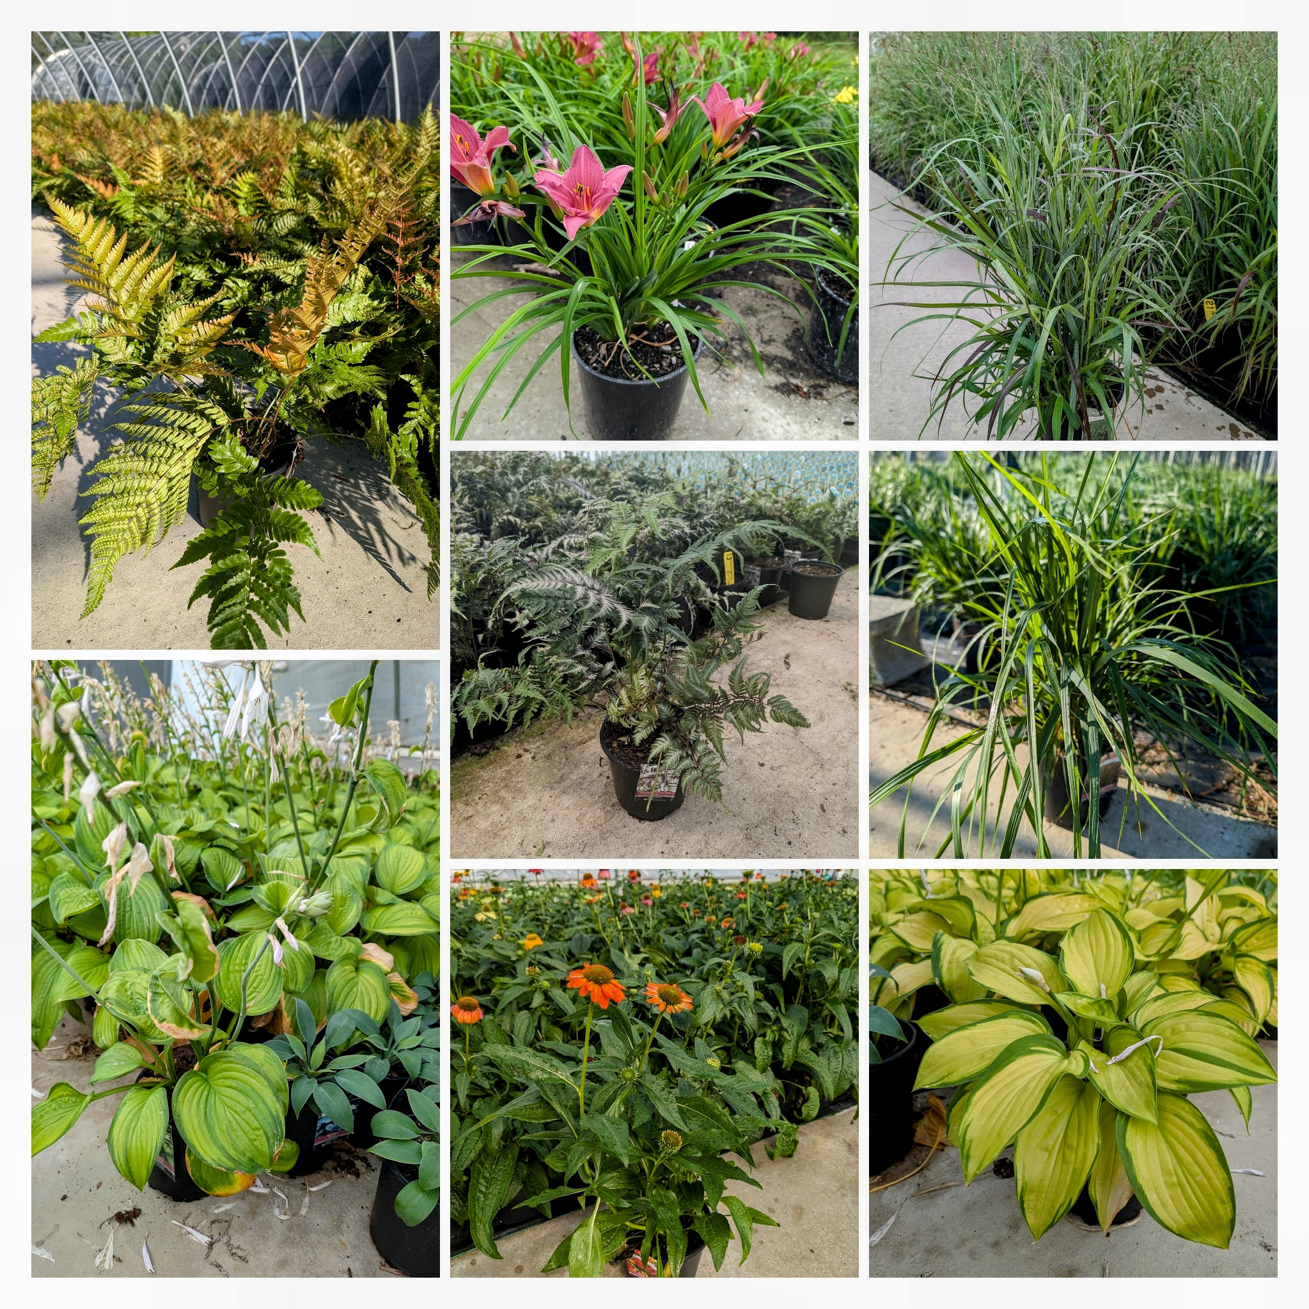
A-Z perennials
Hosta
Fern
Daylily
Grass

Slide 10
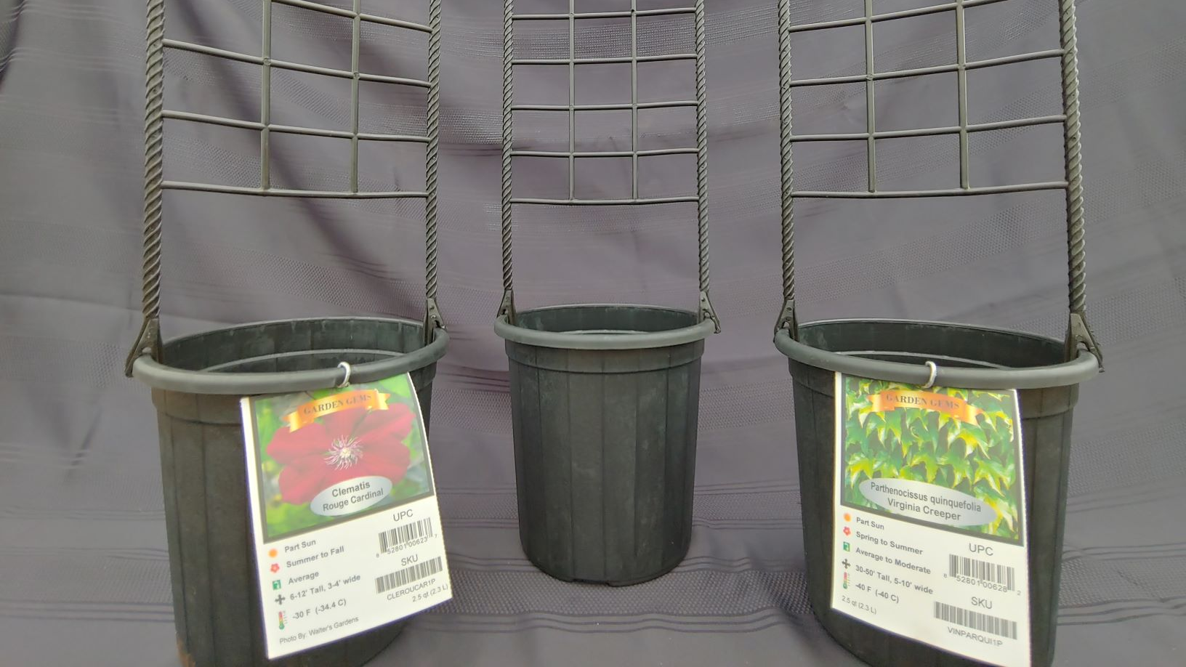
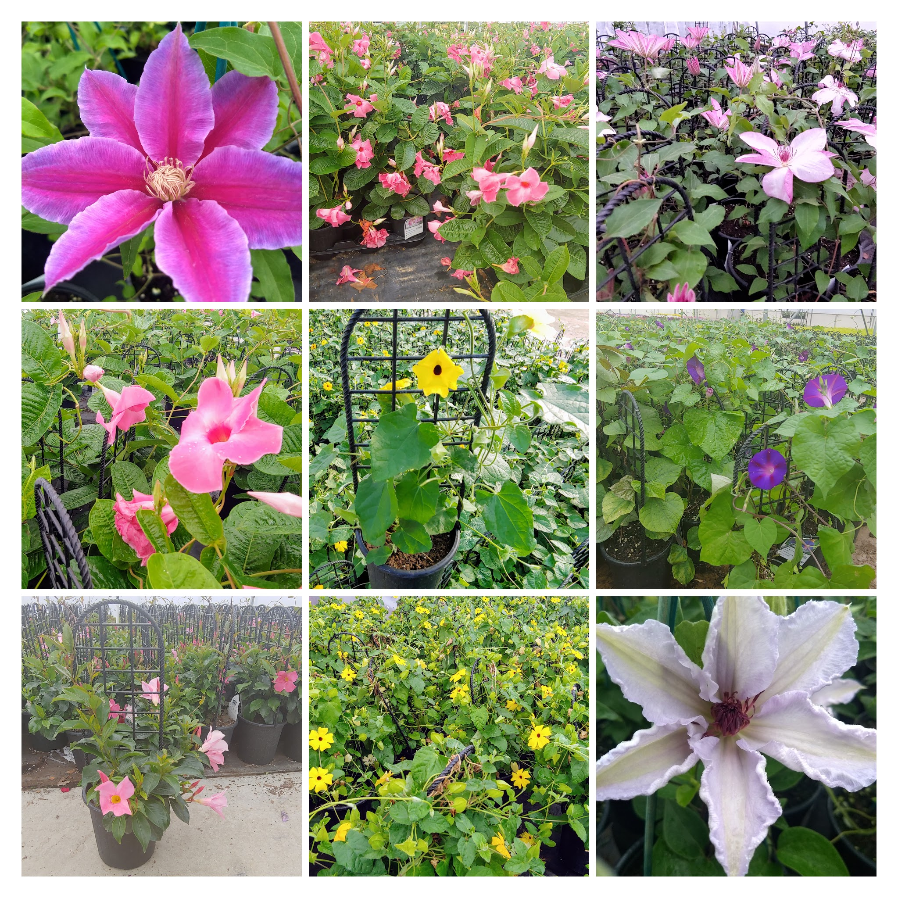
#1 POT VINES W/TRELLIS

Slide 11
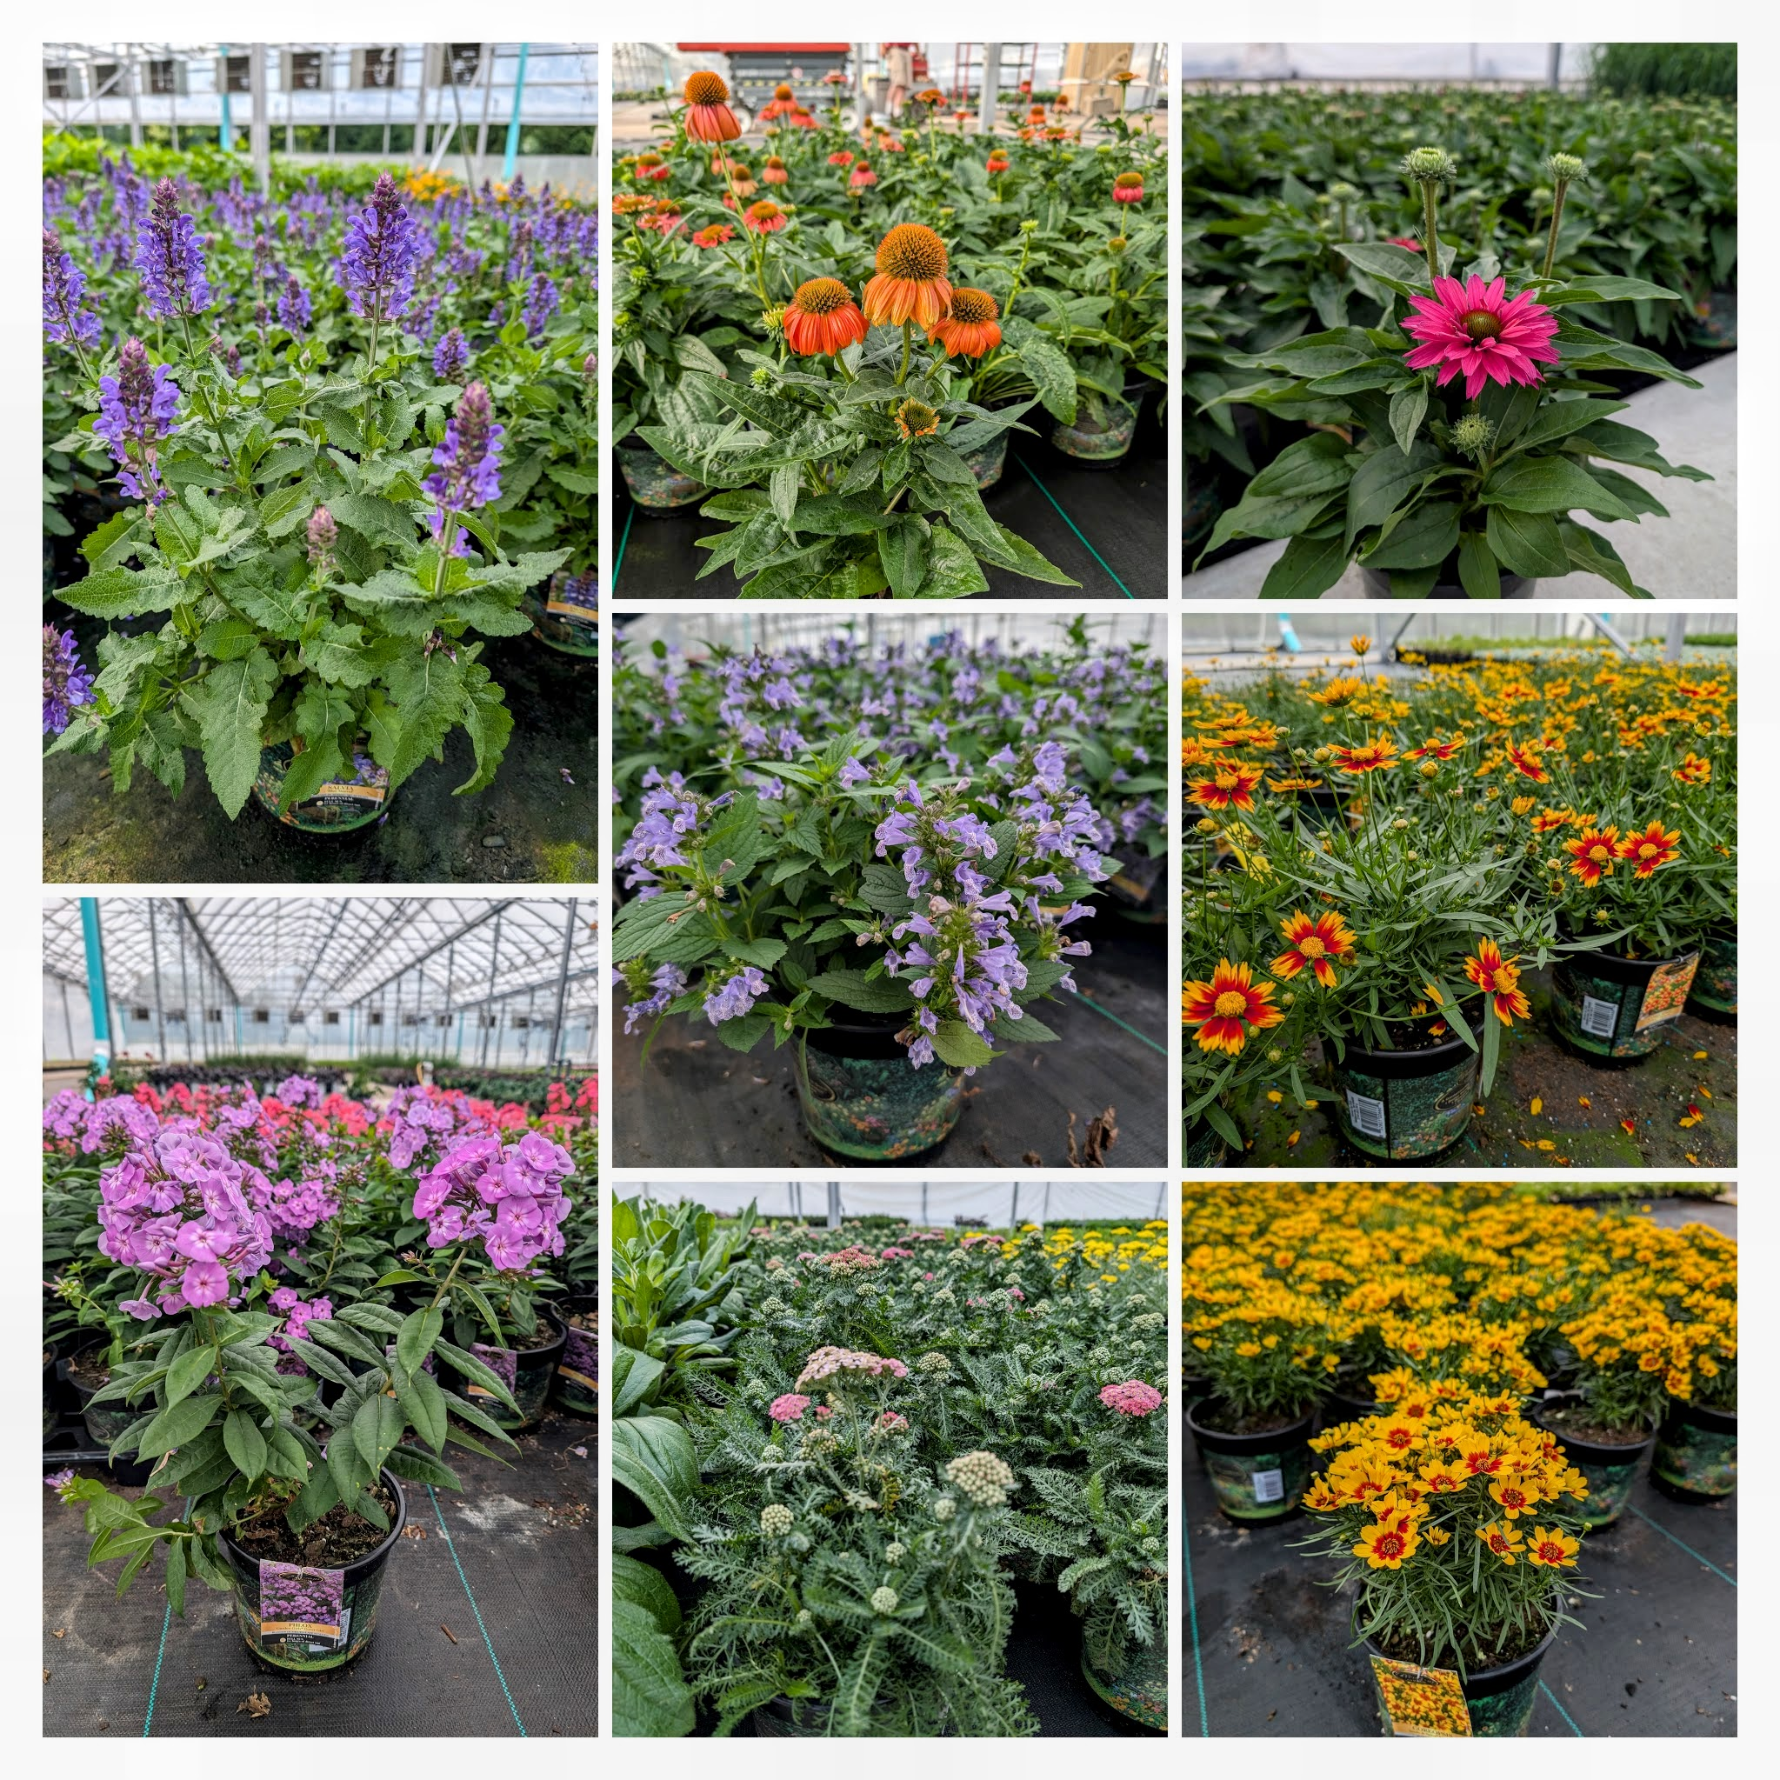

Stunning perennials, stunning color to fit any landscape!

Slide 12
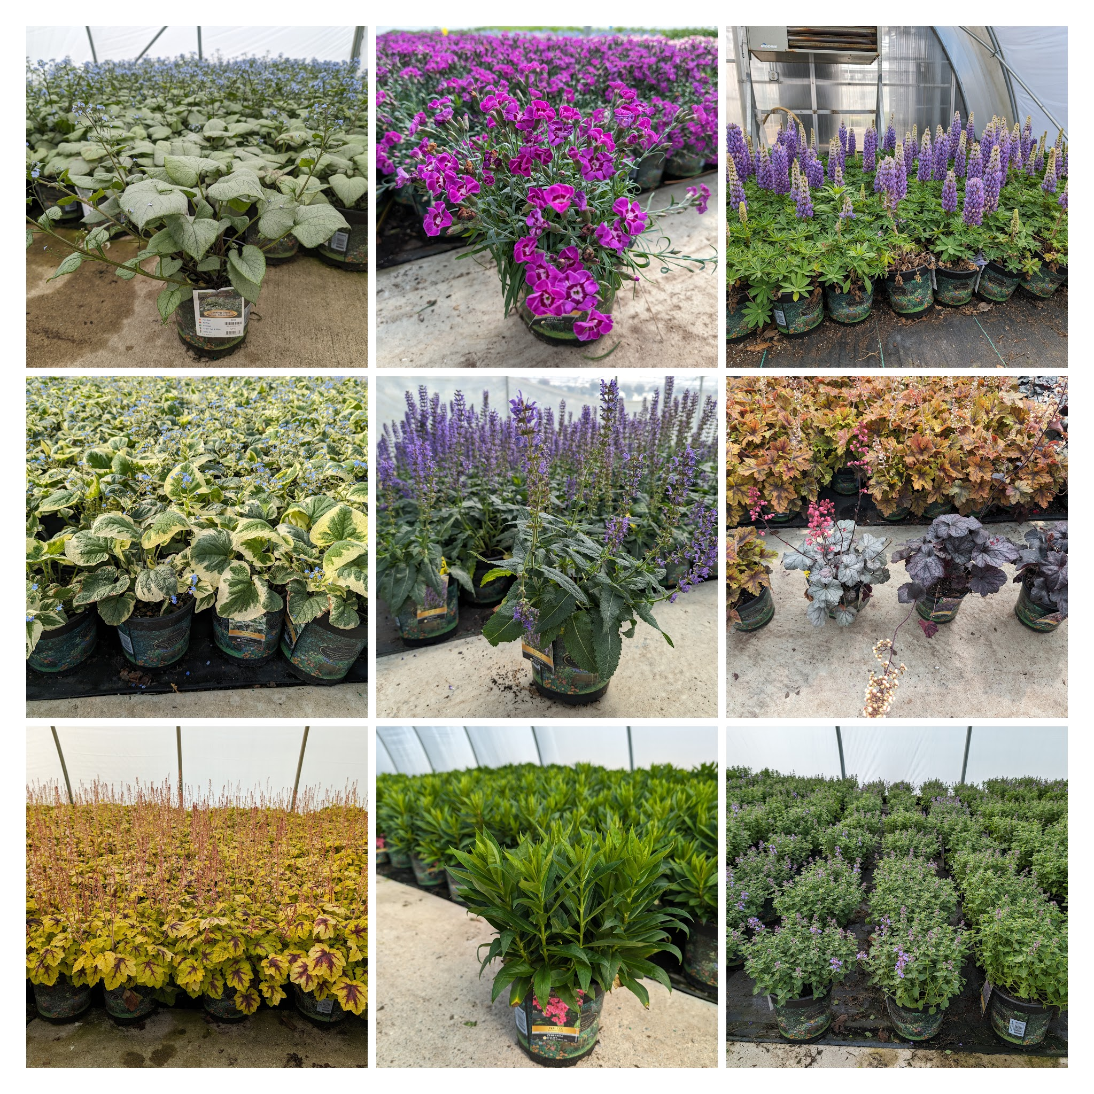
CUSTOMERS NATURALLY GRAVITATE TO THIS GREAT LOOKING PACKAGE!

Slide 13
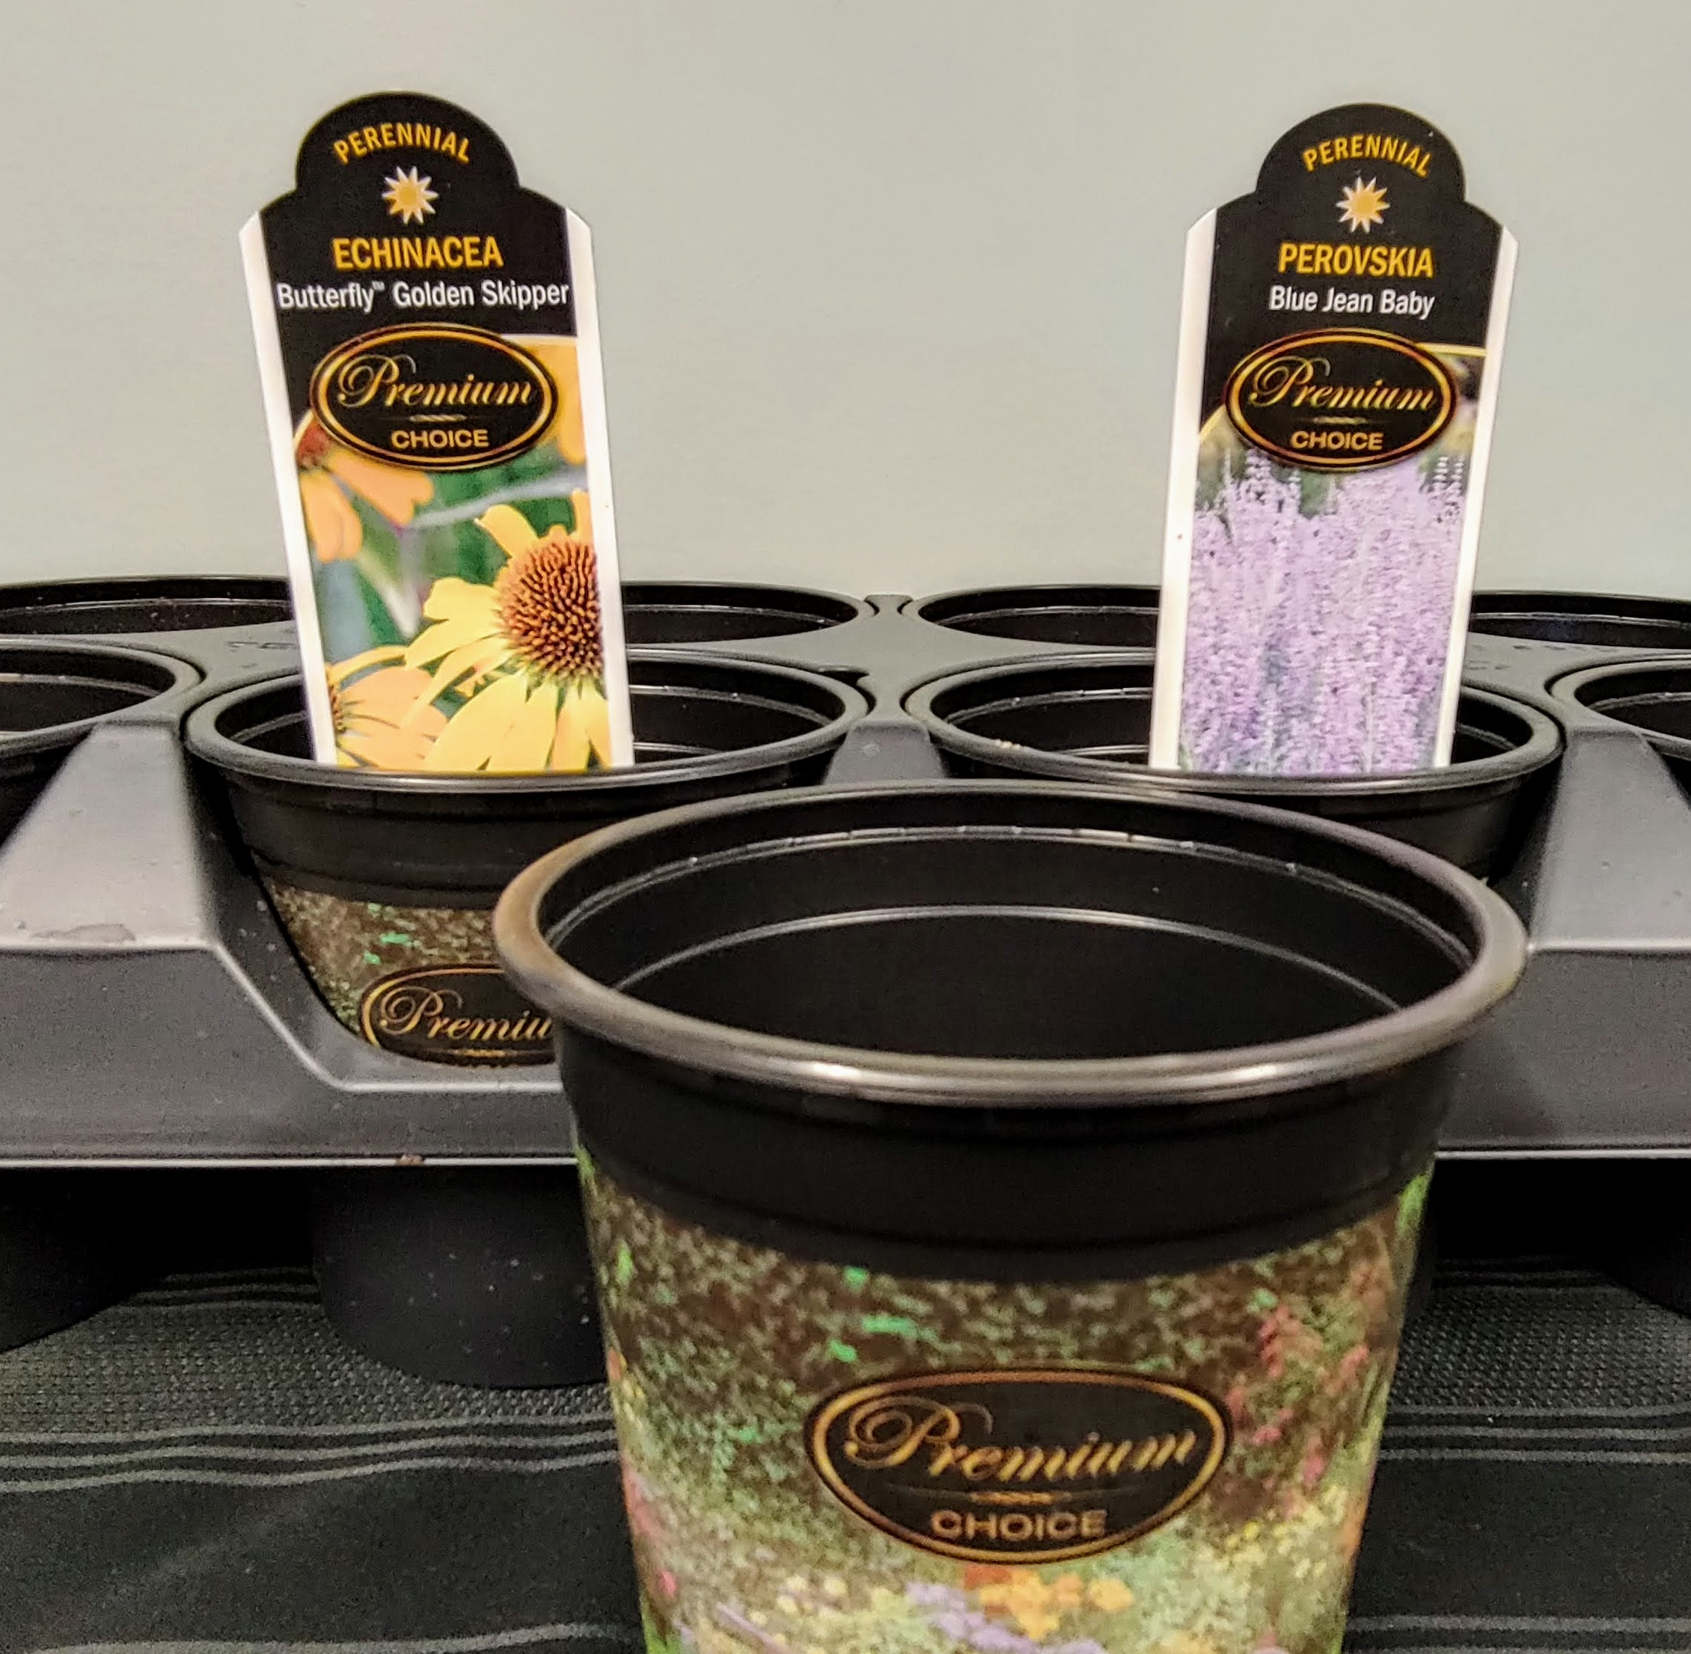
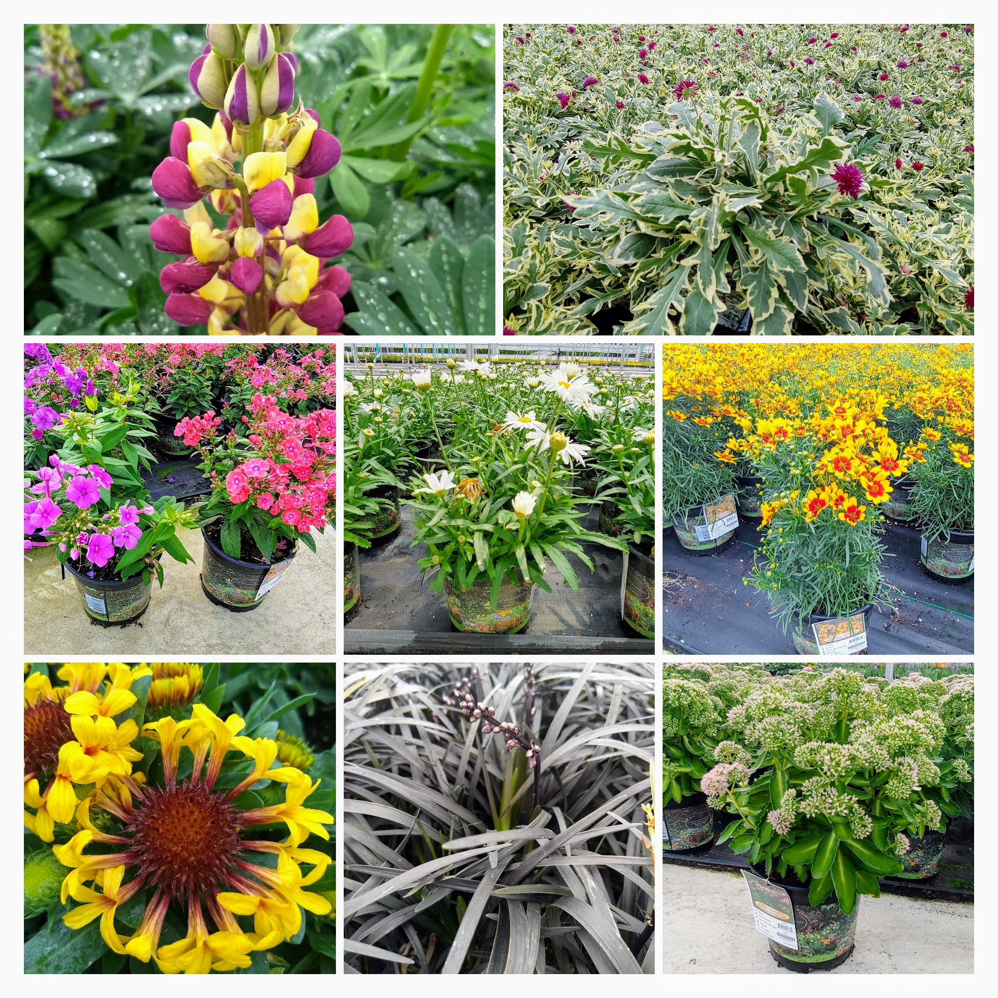
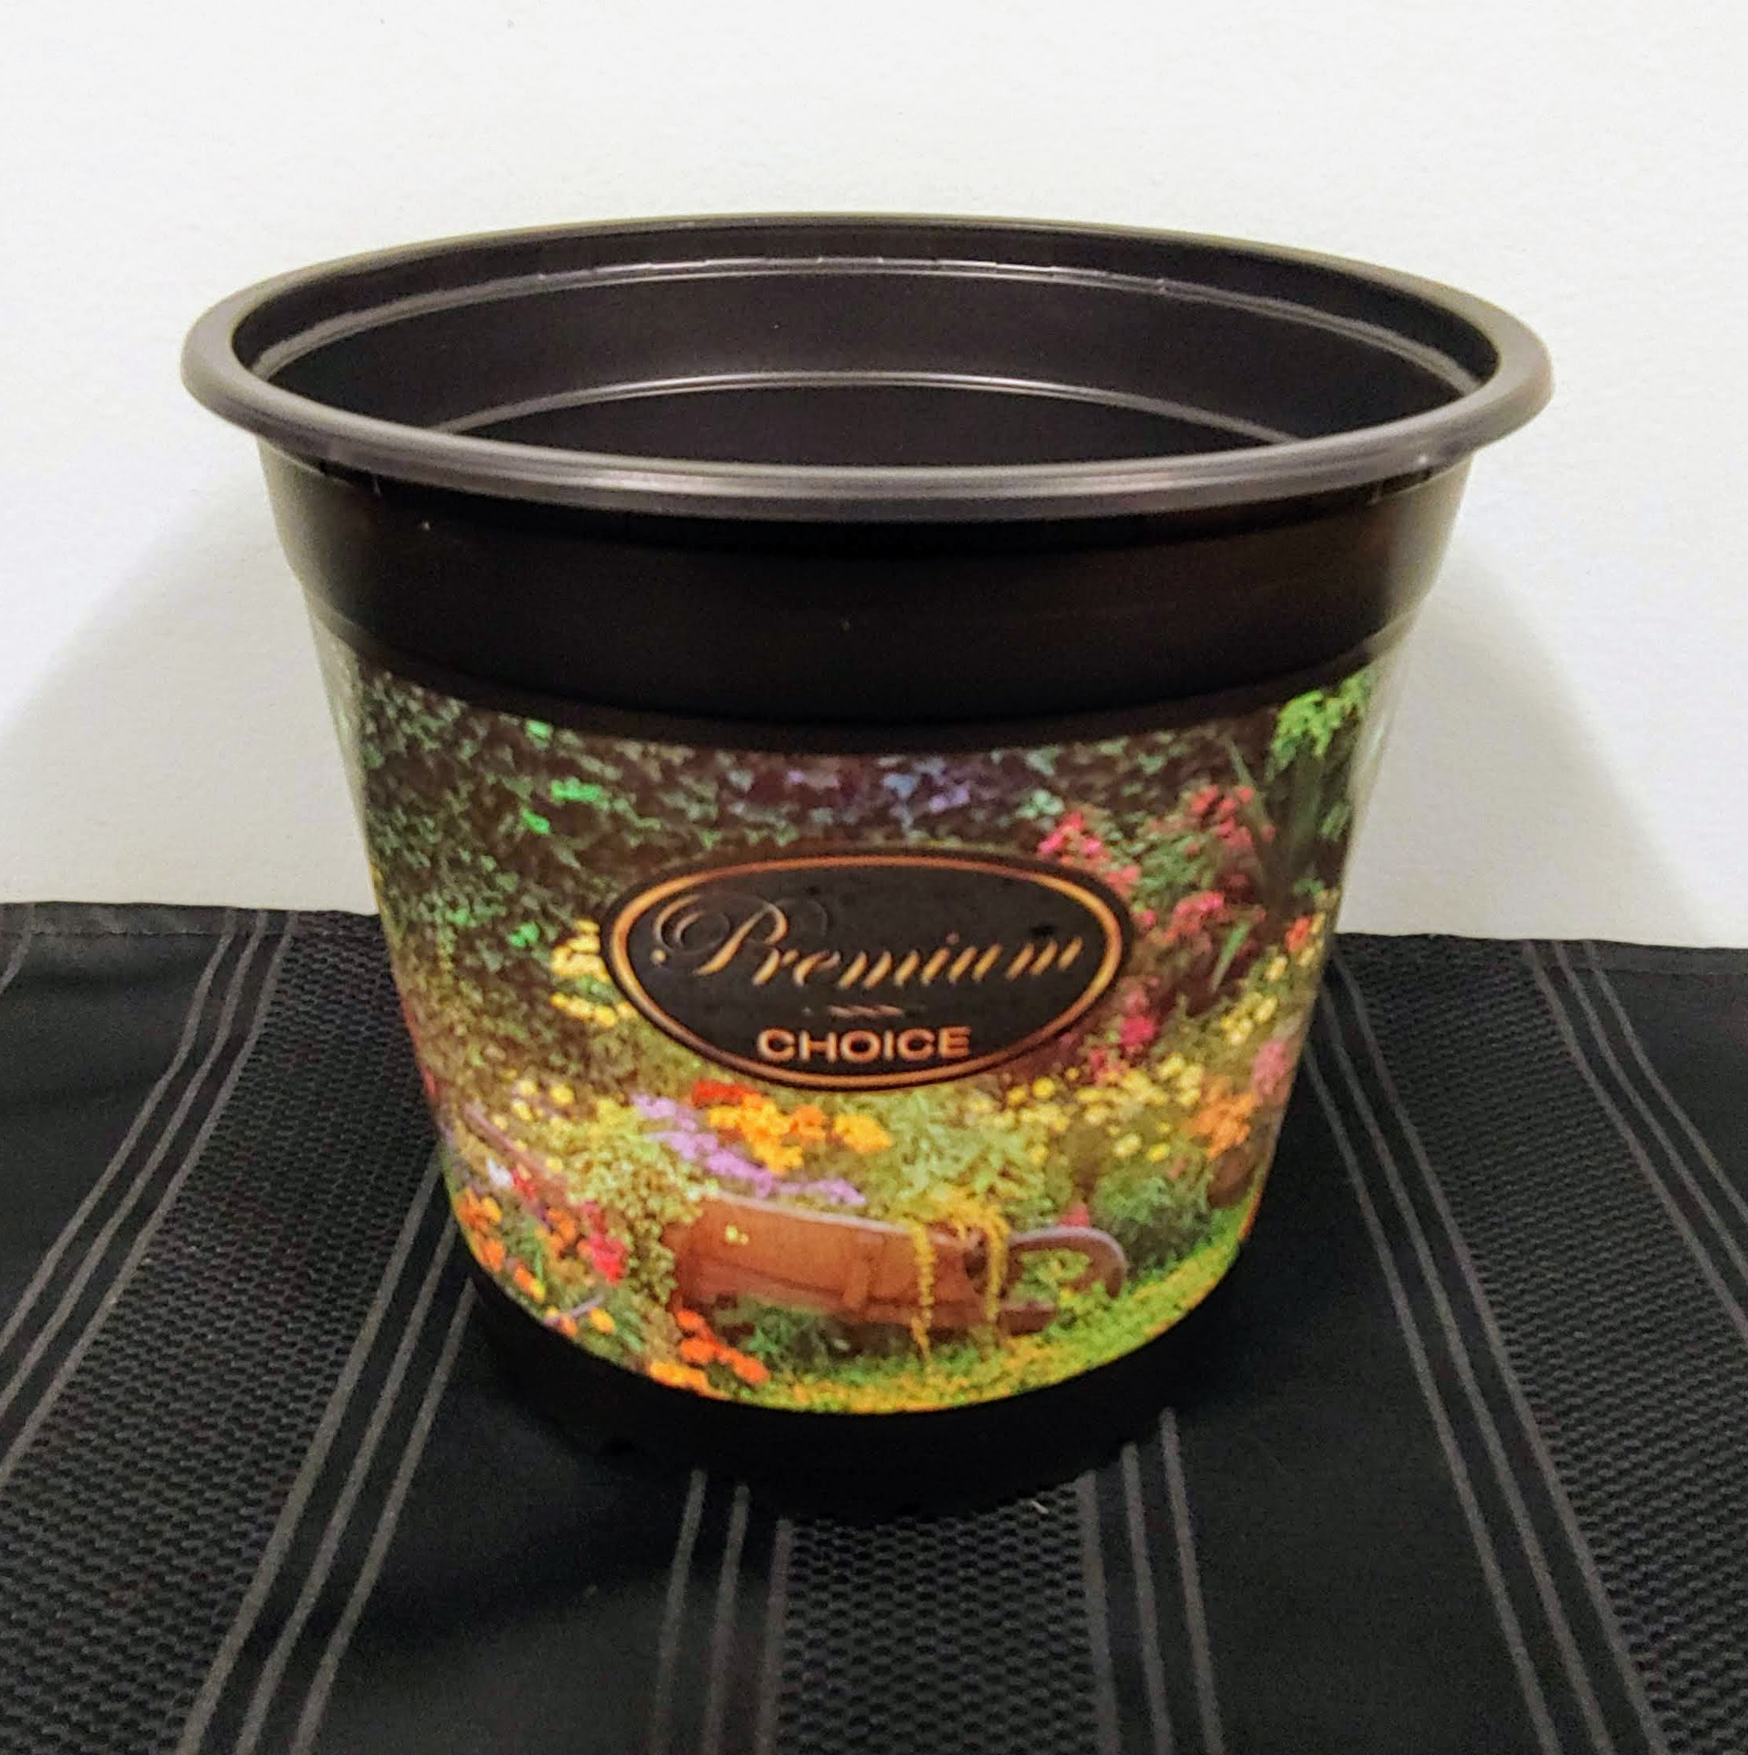
A large variety list from A to Z in a nice colorful pot where your customers will see the PREMIUM nature of the perennial.
Why the higher price point? Just paying a little more for royalties and new genetics.
This is offered in our #1 Pot (2.5 qt) and a round 5"-quart pot.

Slide 14
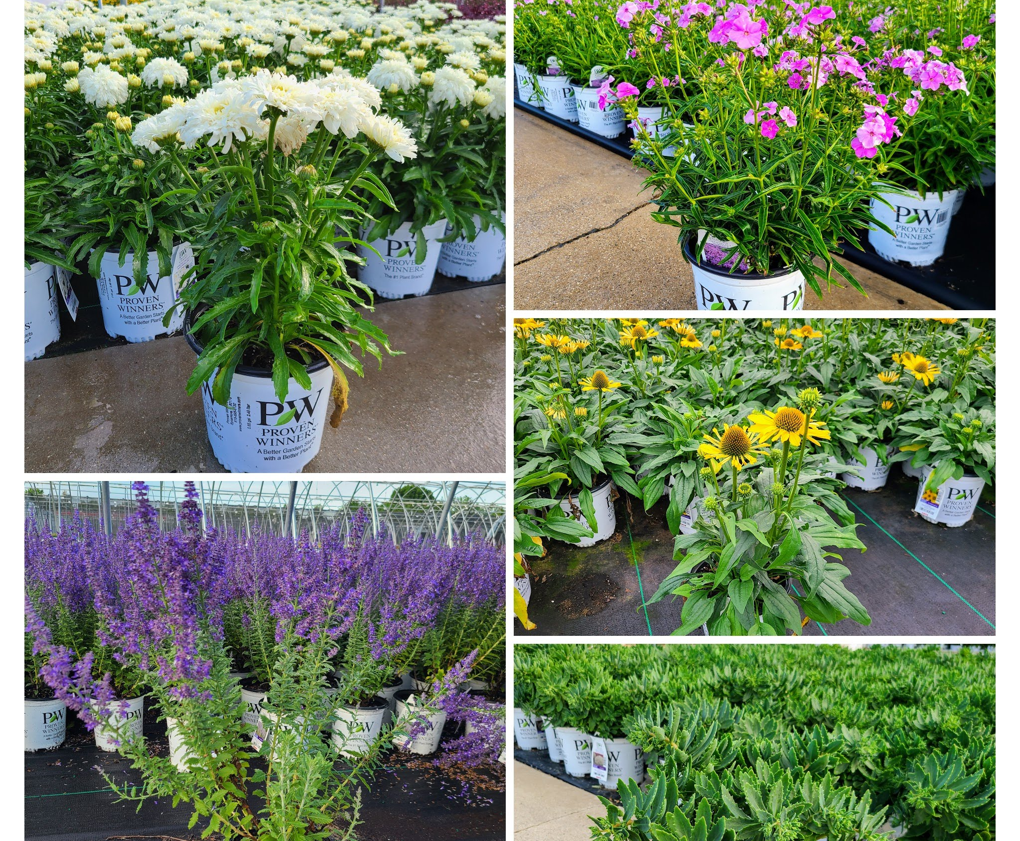

One of the largest selection of PW perennials in both the #1pot and in the quart pot.

Slide 15
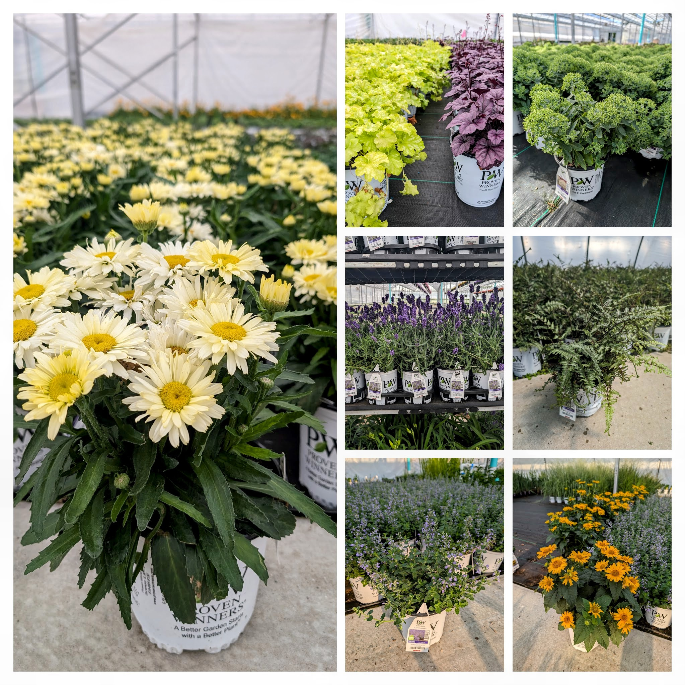

Slide 16
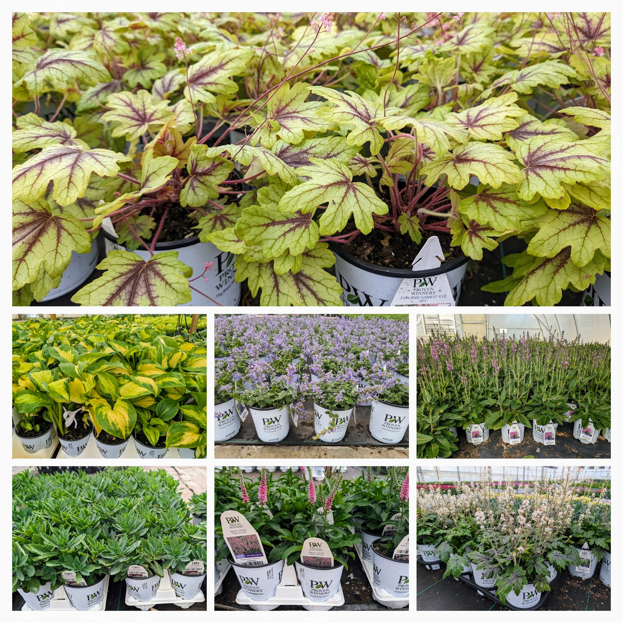

Slide 17
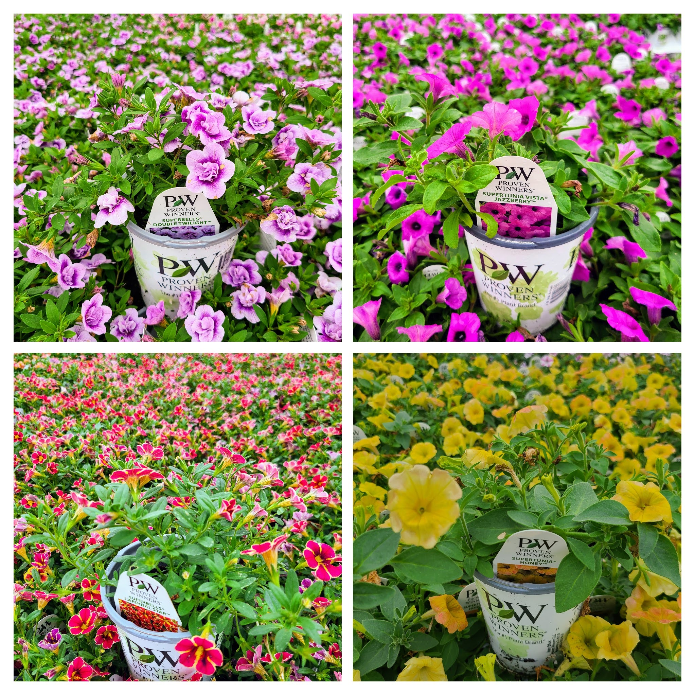
Proven Winner Grande Annuals

Slide 18
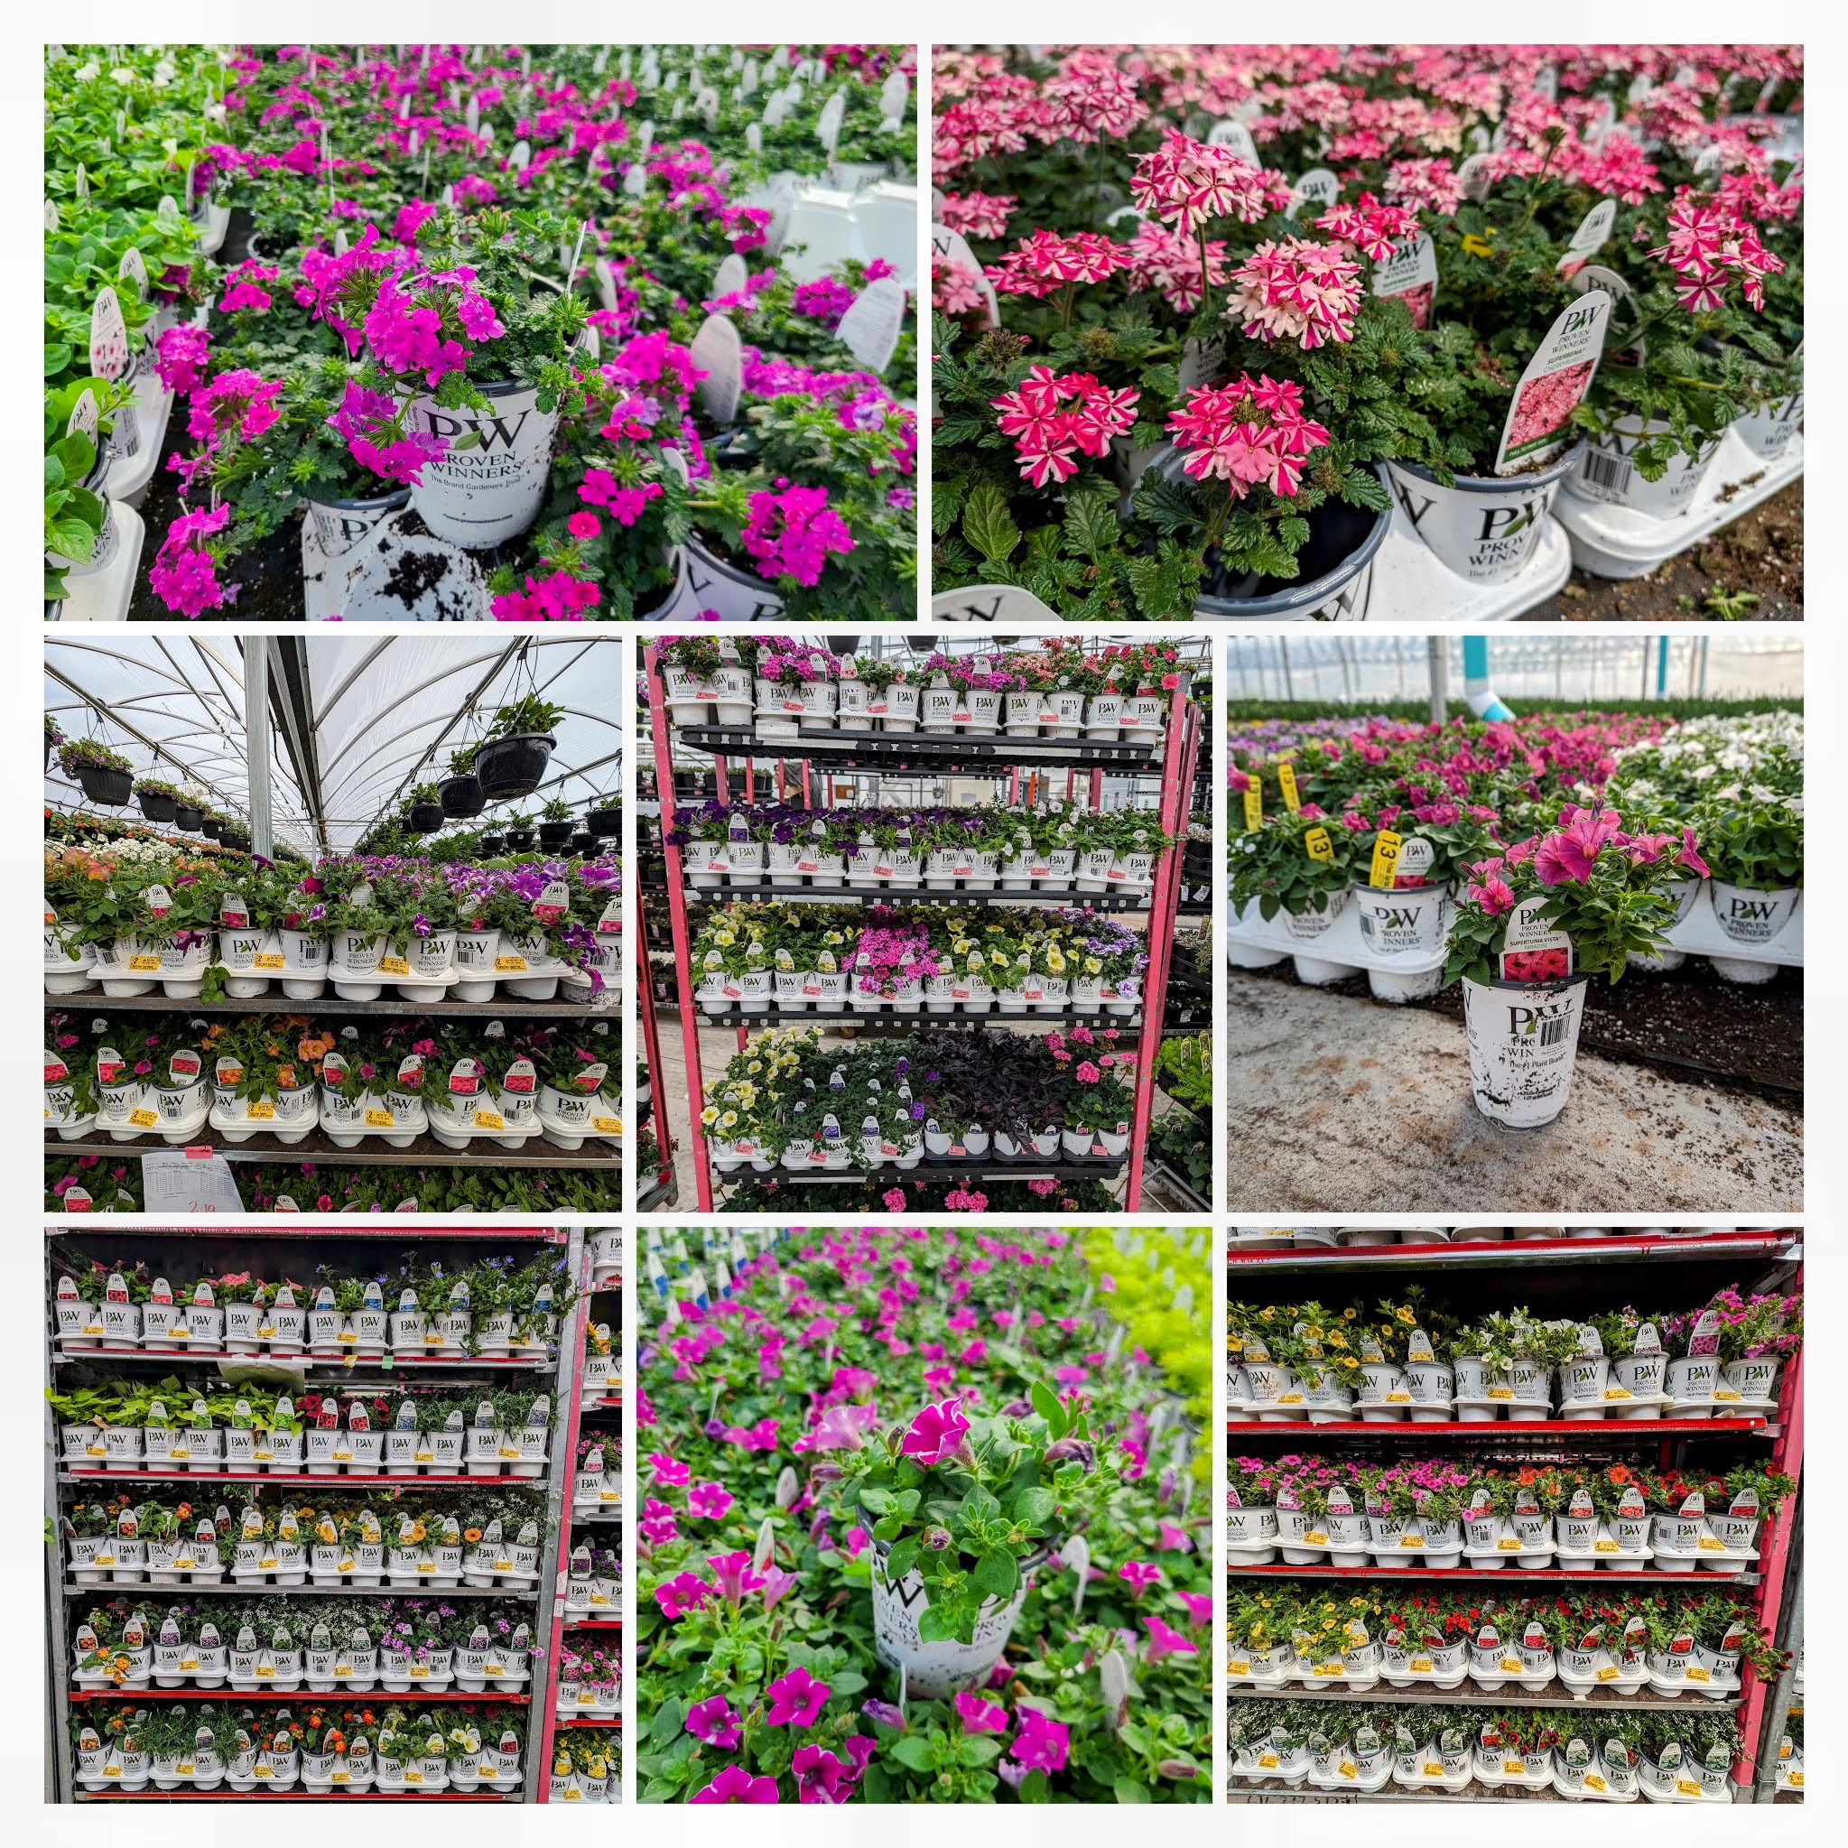
Large selection of 4.25” Grande Annuals in the Proven Winner line. Offering over 70 different varieties.

Slide 19
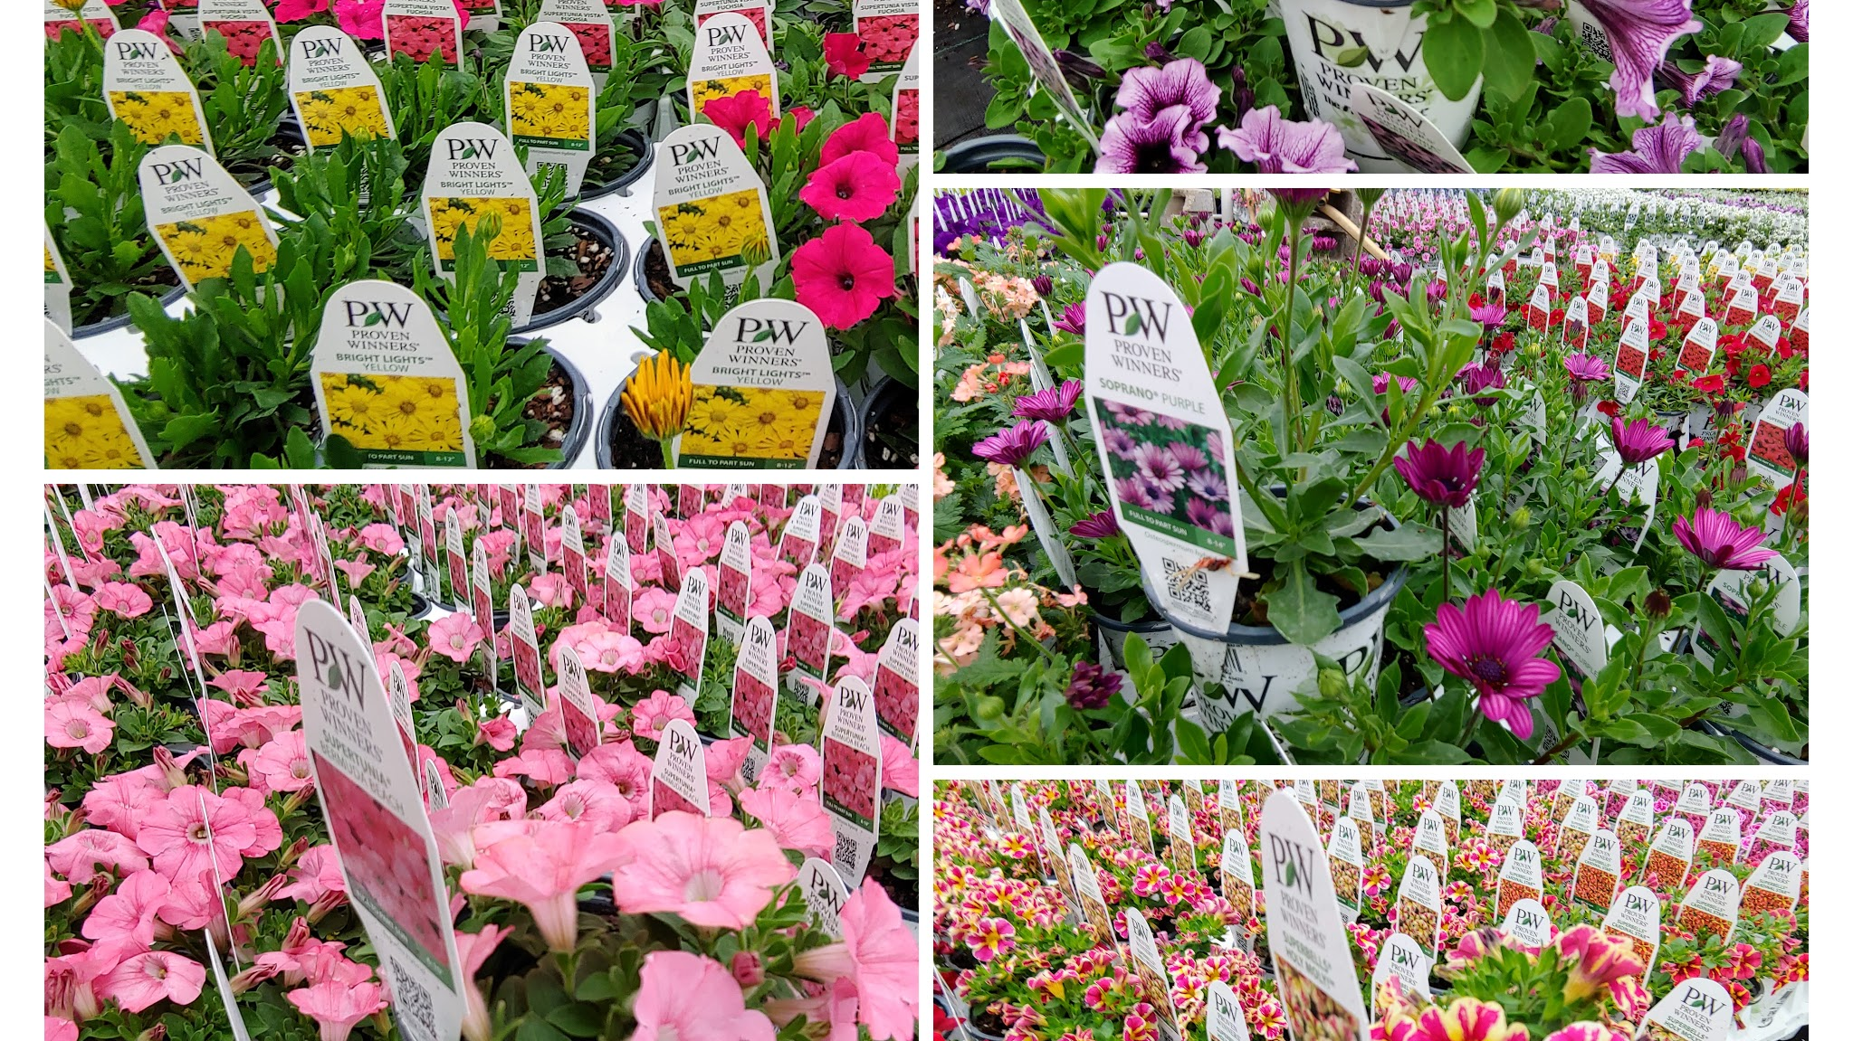

Slide 20
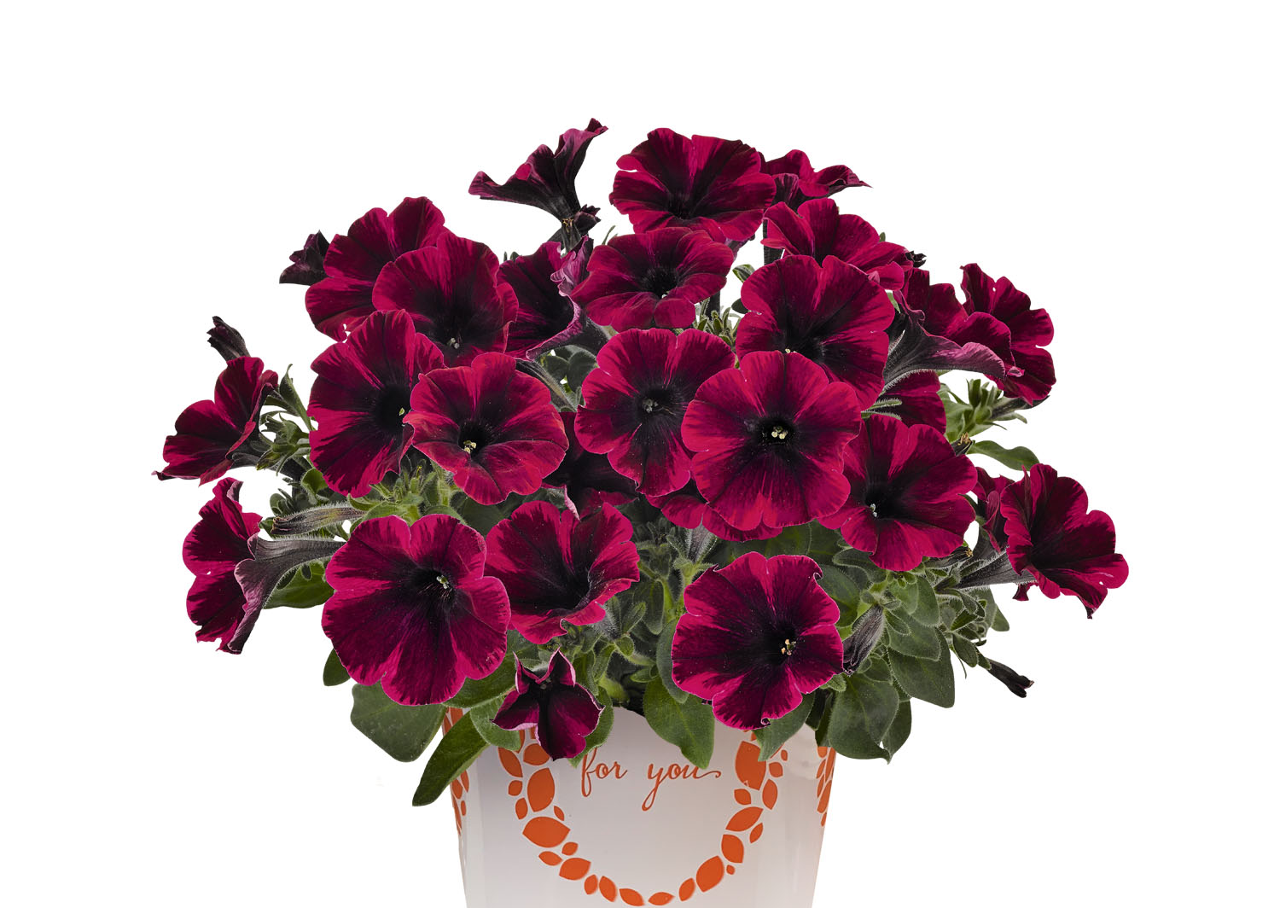
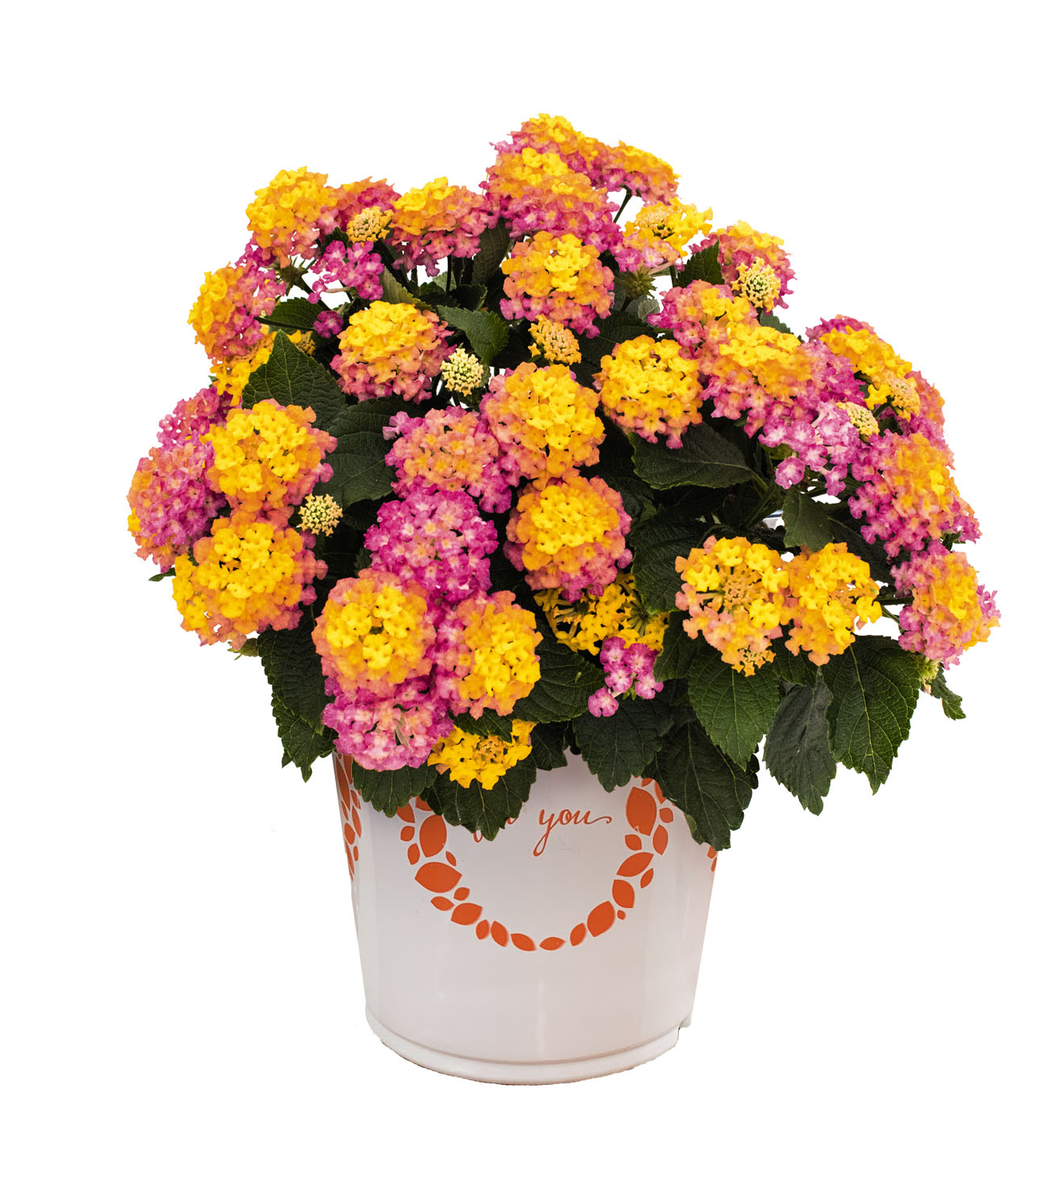
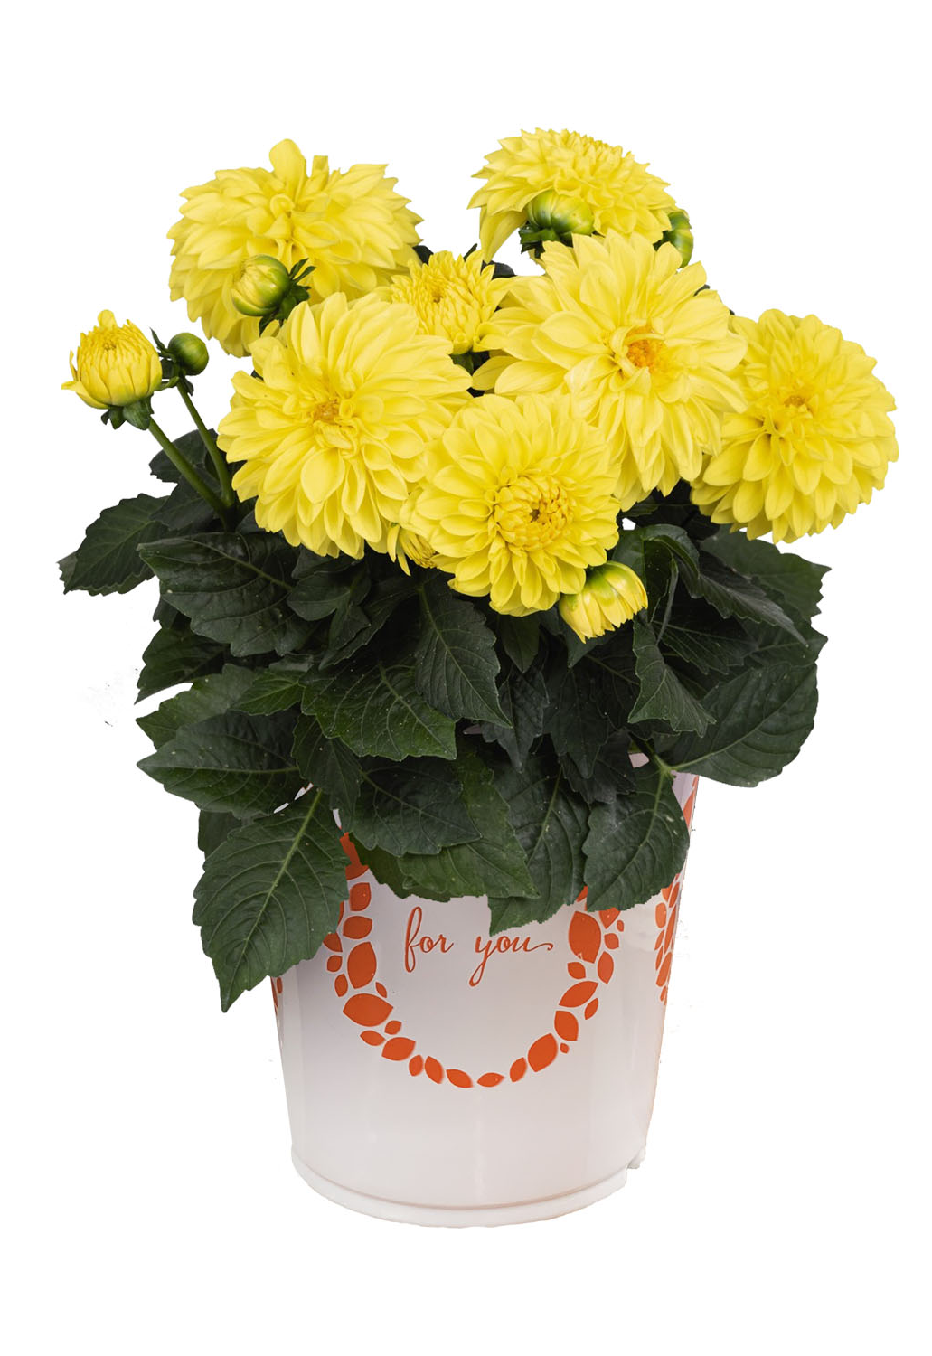

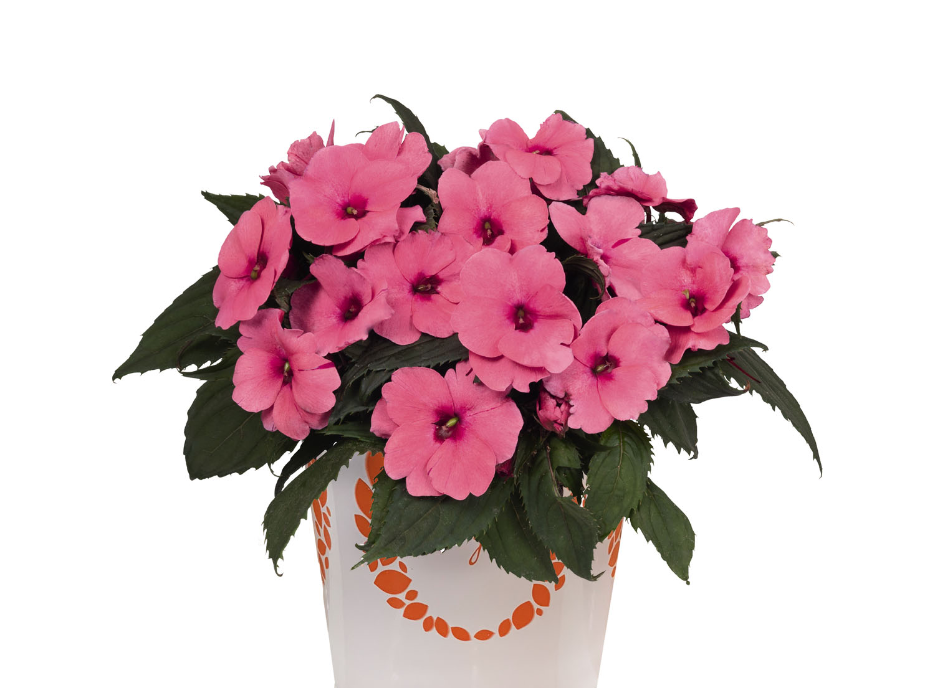

Slide 21
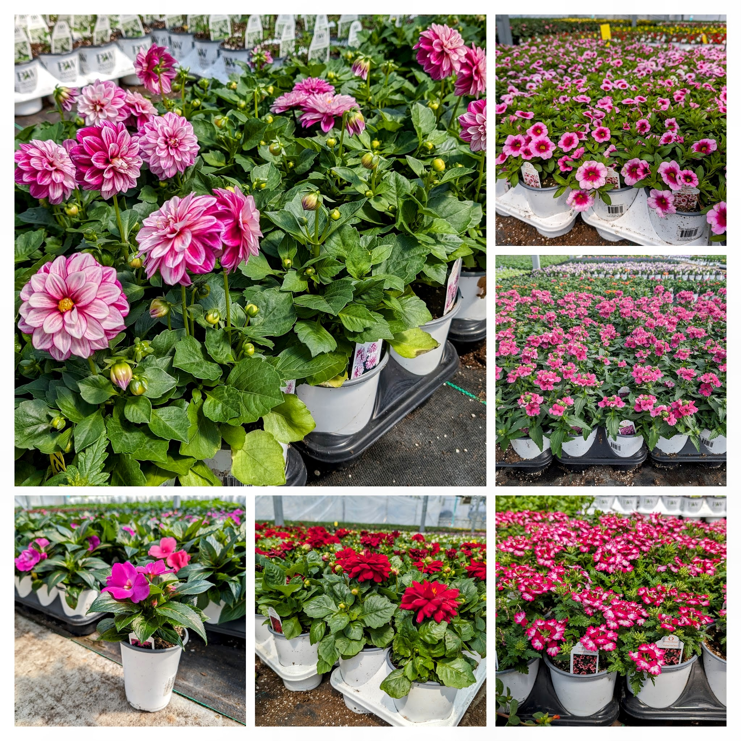
Over 90 different varieties in the “For You” line giving your customers a large selection of annuals for their planters and or annual beds!

Slide 22
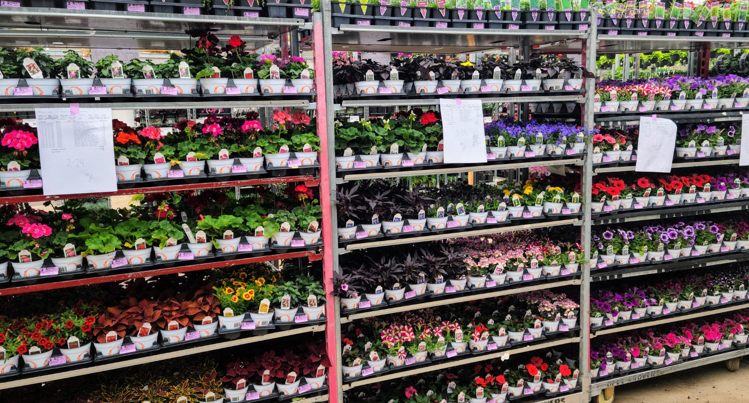

Slide 23
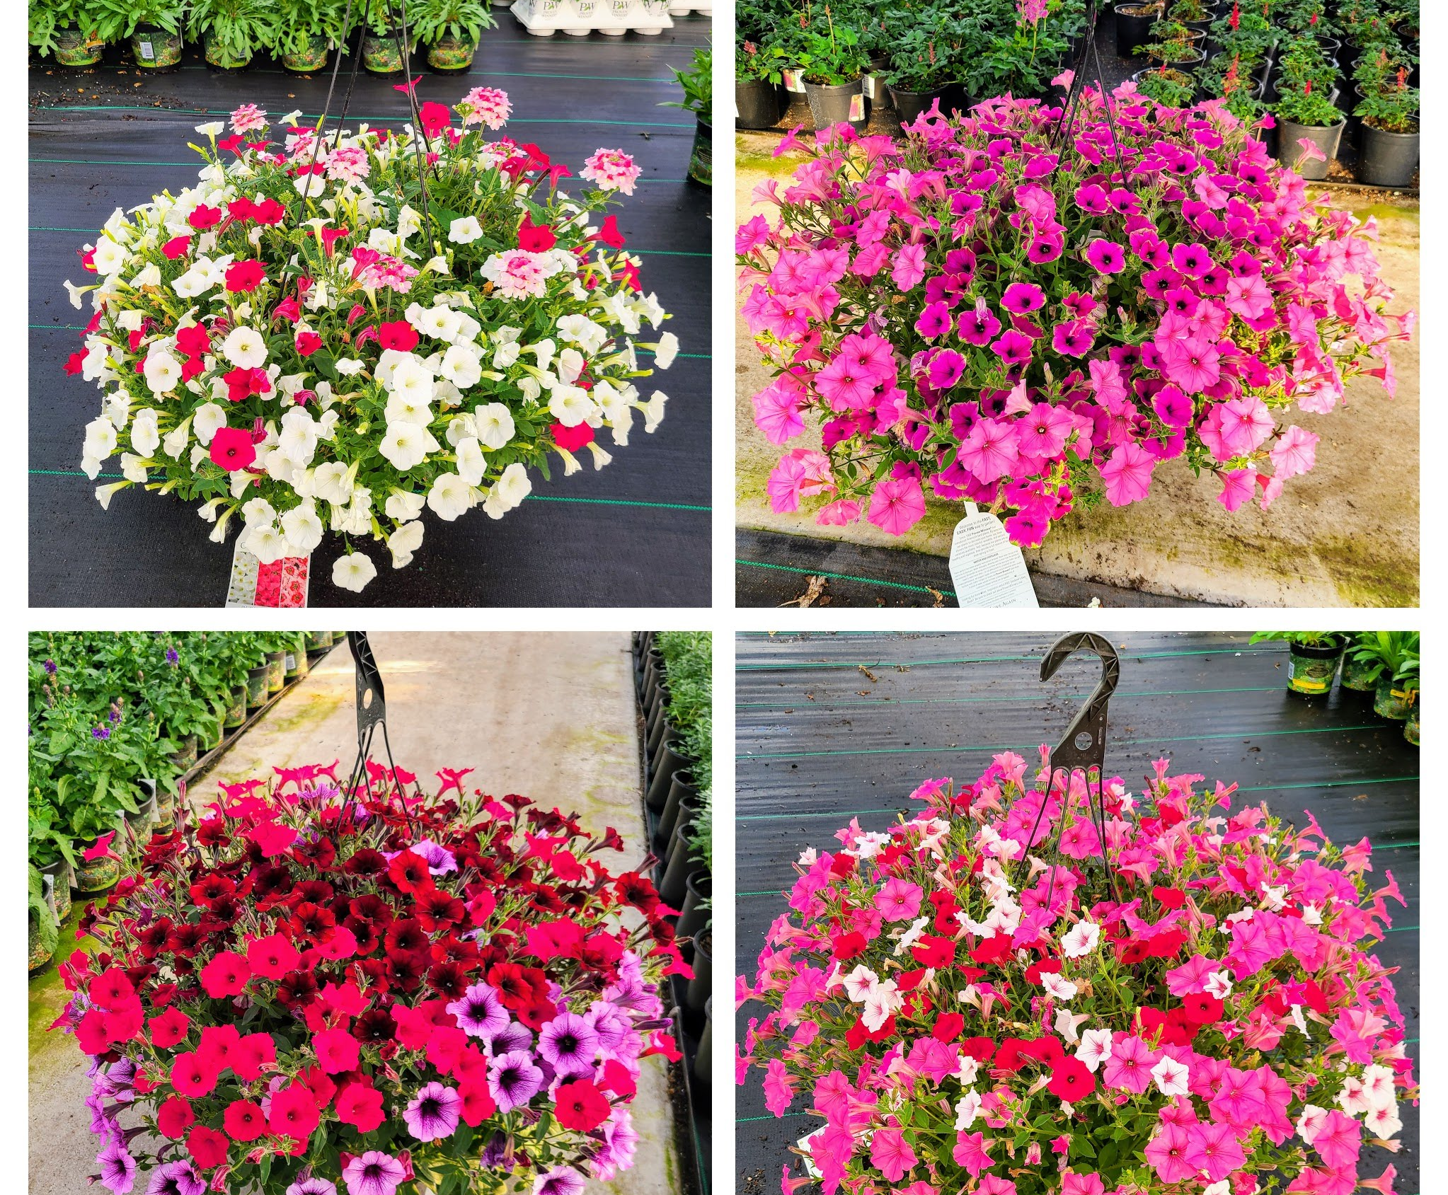
12-in Premium Hanging Baskets
Large 12-in Combo Baskets
Up to 24 different Proven Winner combinations
Begonia Combos
Calibrachoa Combos
Fuchsia Combos
Geranium Combos
Multi Species Combos

Slide 24
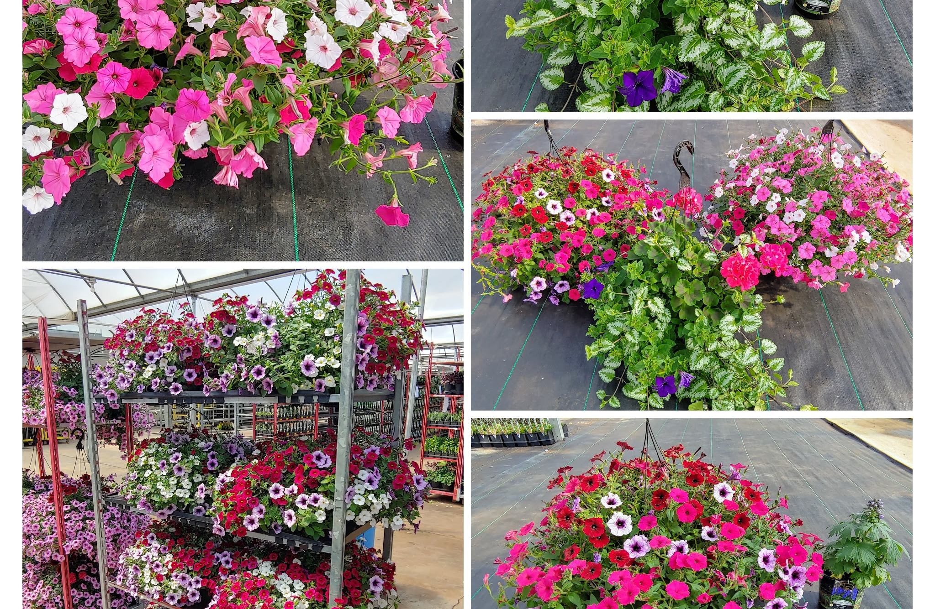
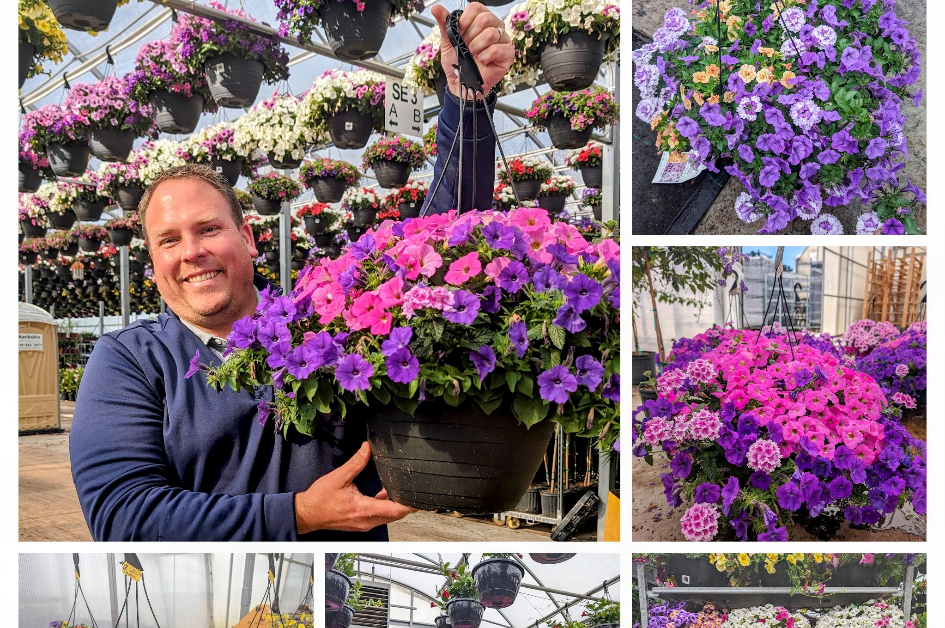
MORE 12-IN BASKETS
Garden Center quality that you will not see in box stores!

Slide 25
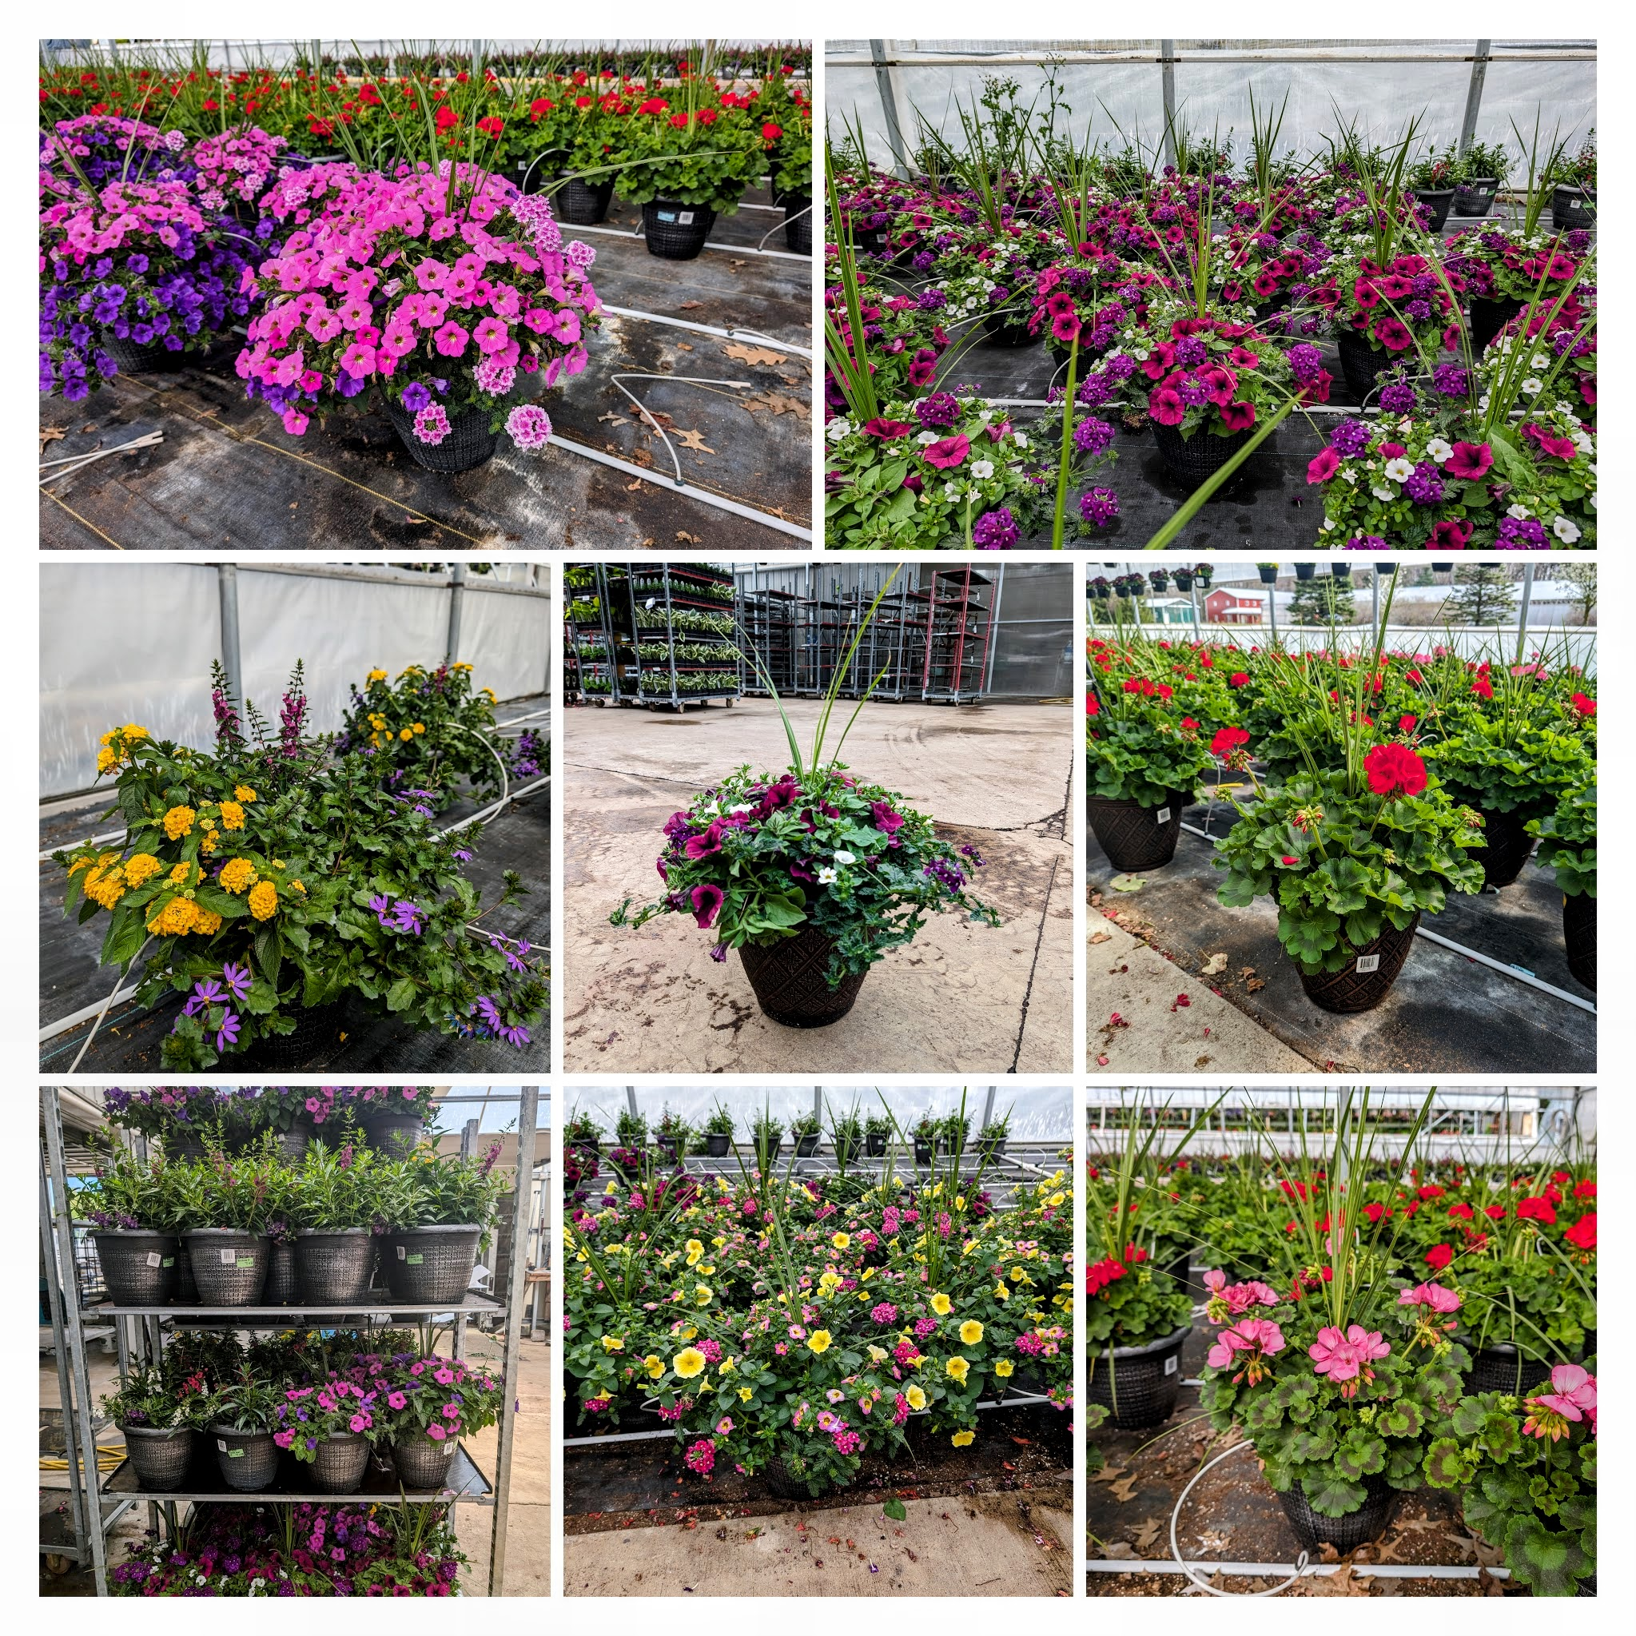
12-IN PATIO POTS

Slide 26
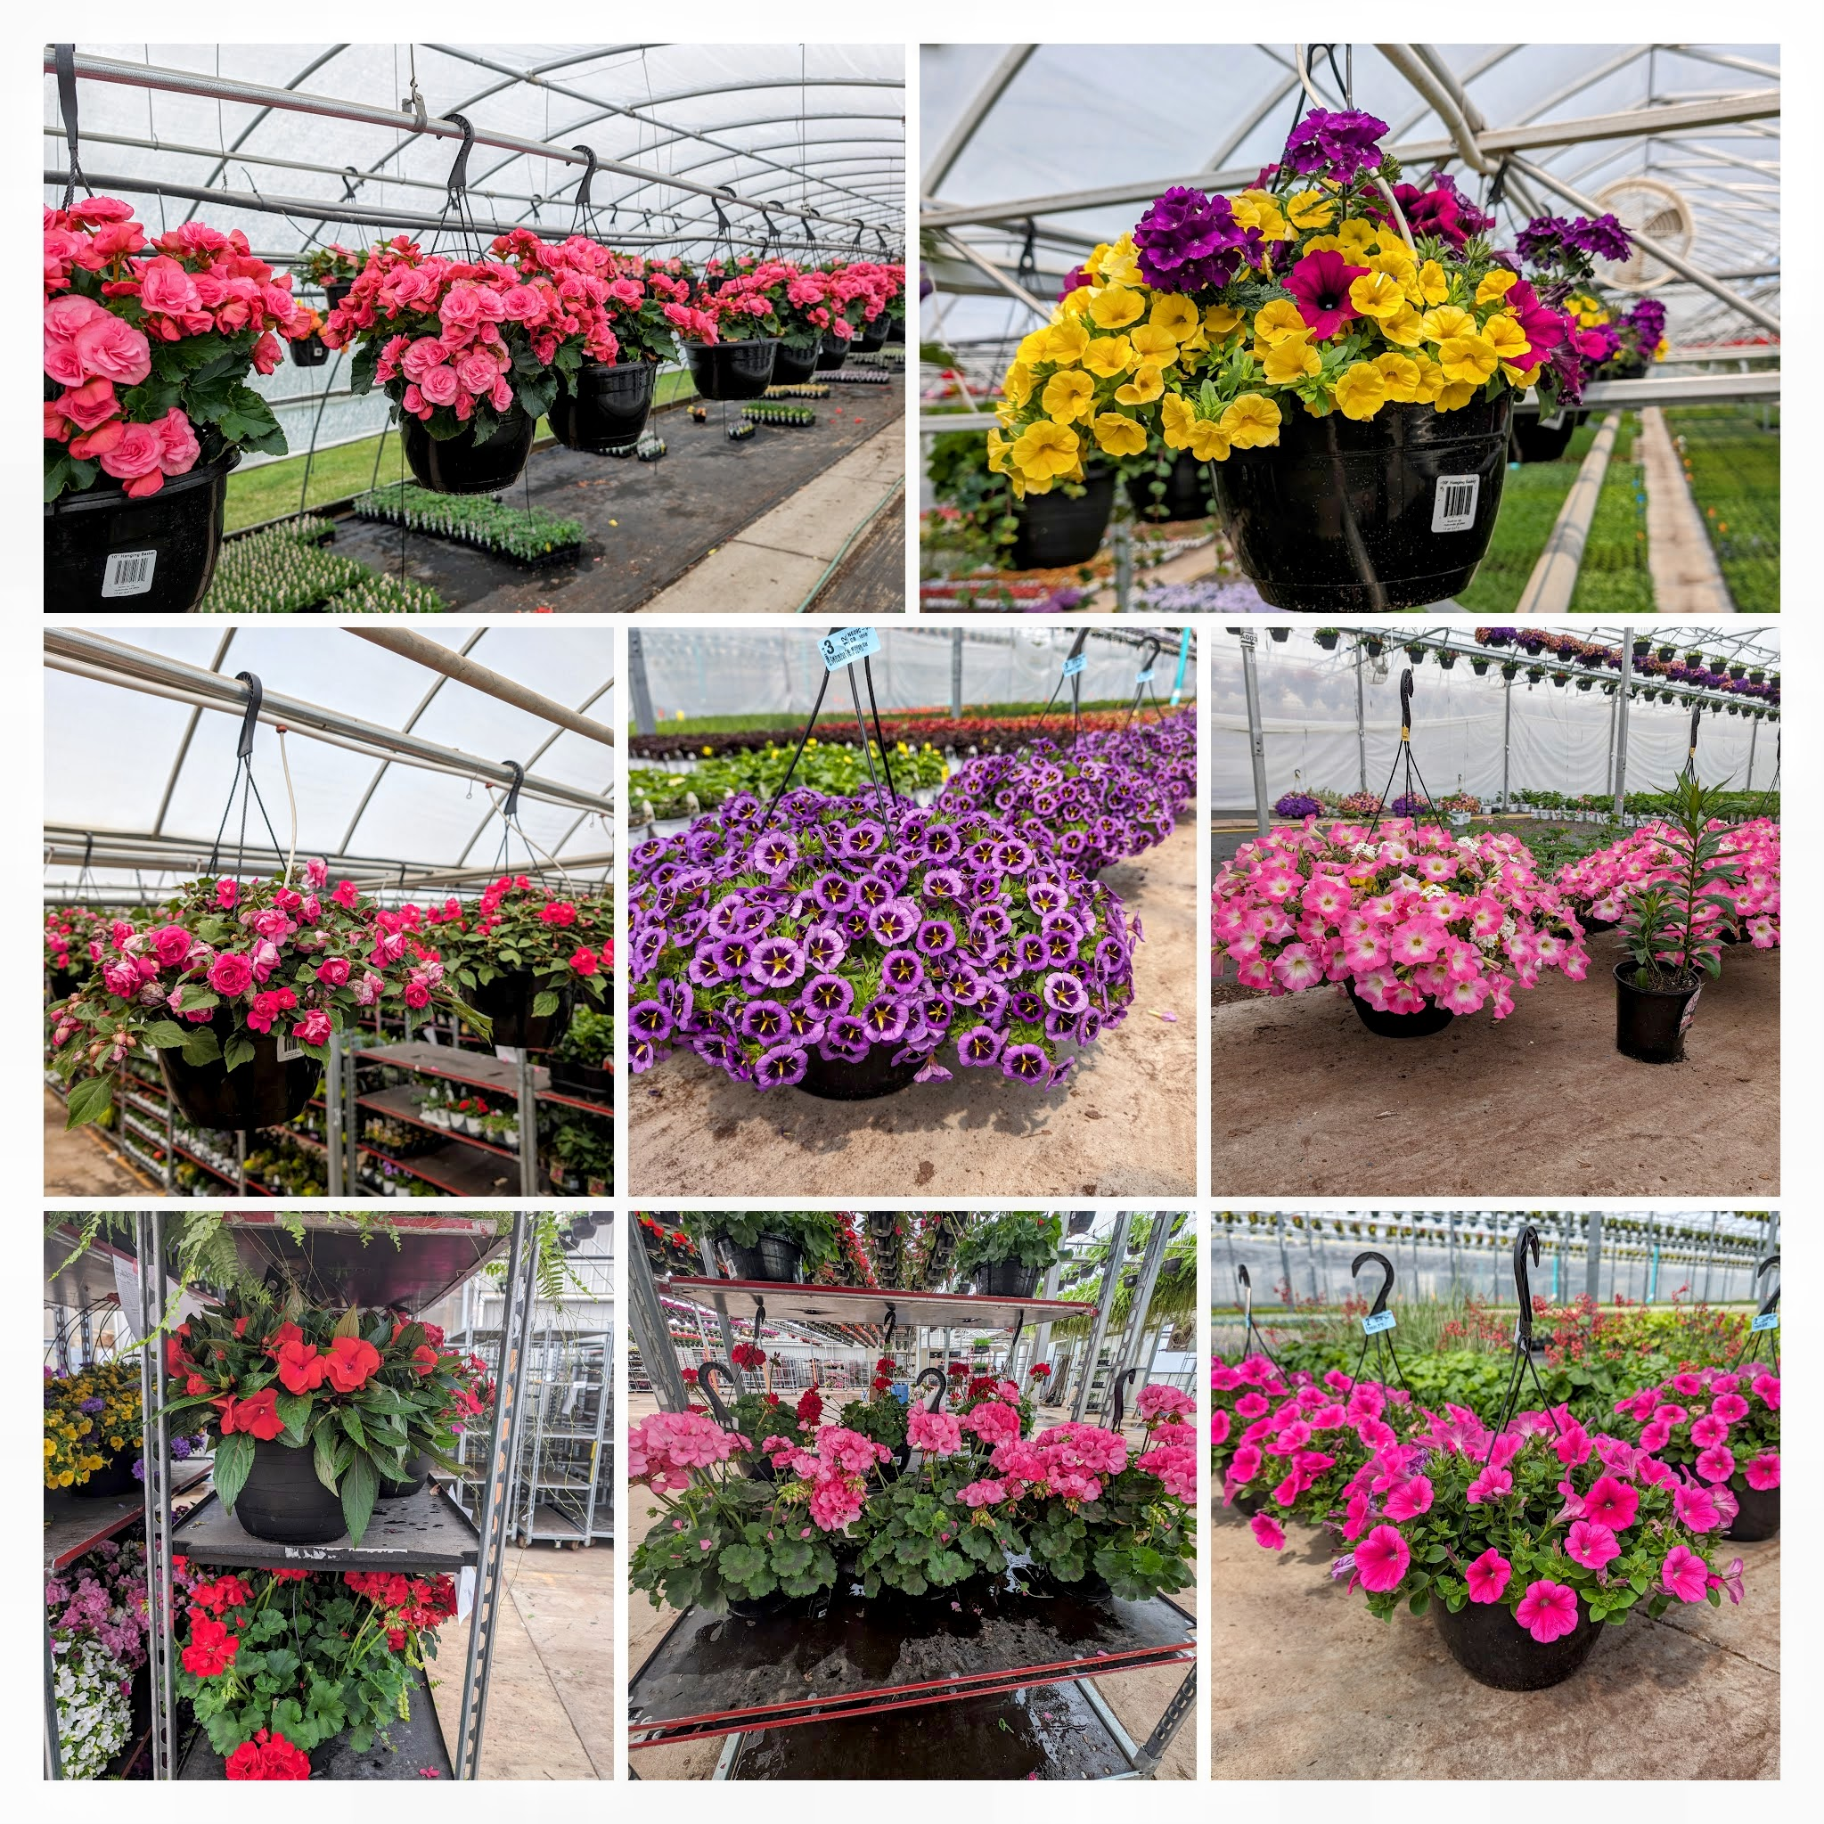
10-in Hanging Baskets
Large selection of 10-in baskets in both combos and mono's
Better than the "promo" basket you see in the box stores!

Slide 27
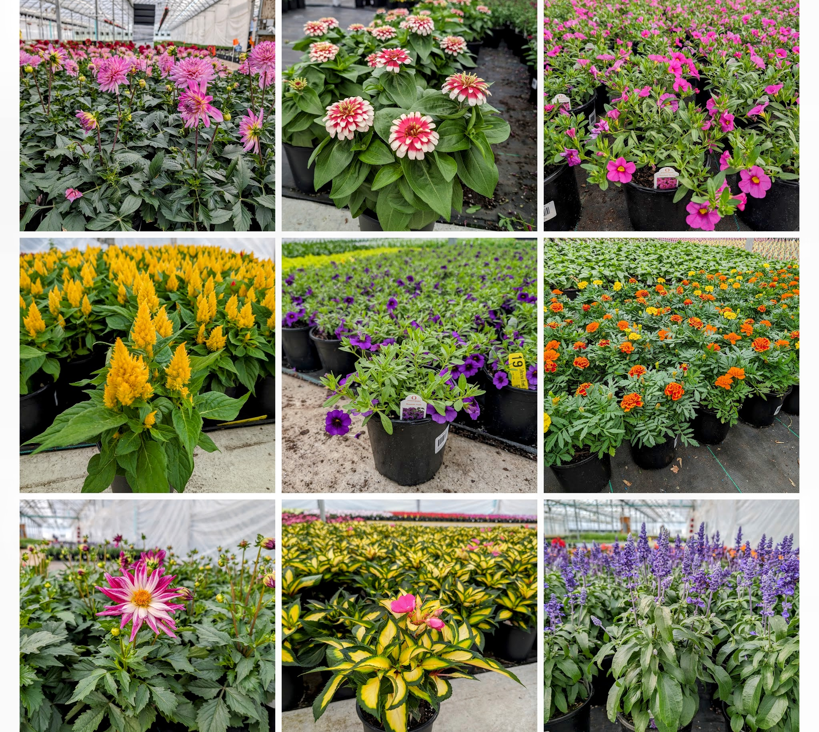
6-in Gallon Annuals
A large selection of 6-in annuals to provide instant gratification for your customers who want big!

Slide 28
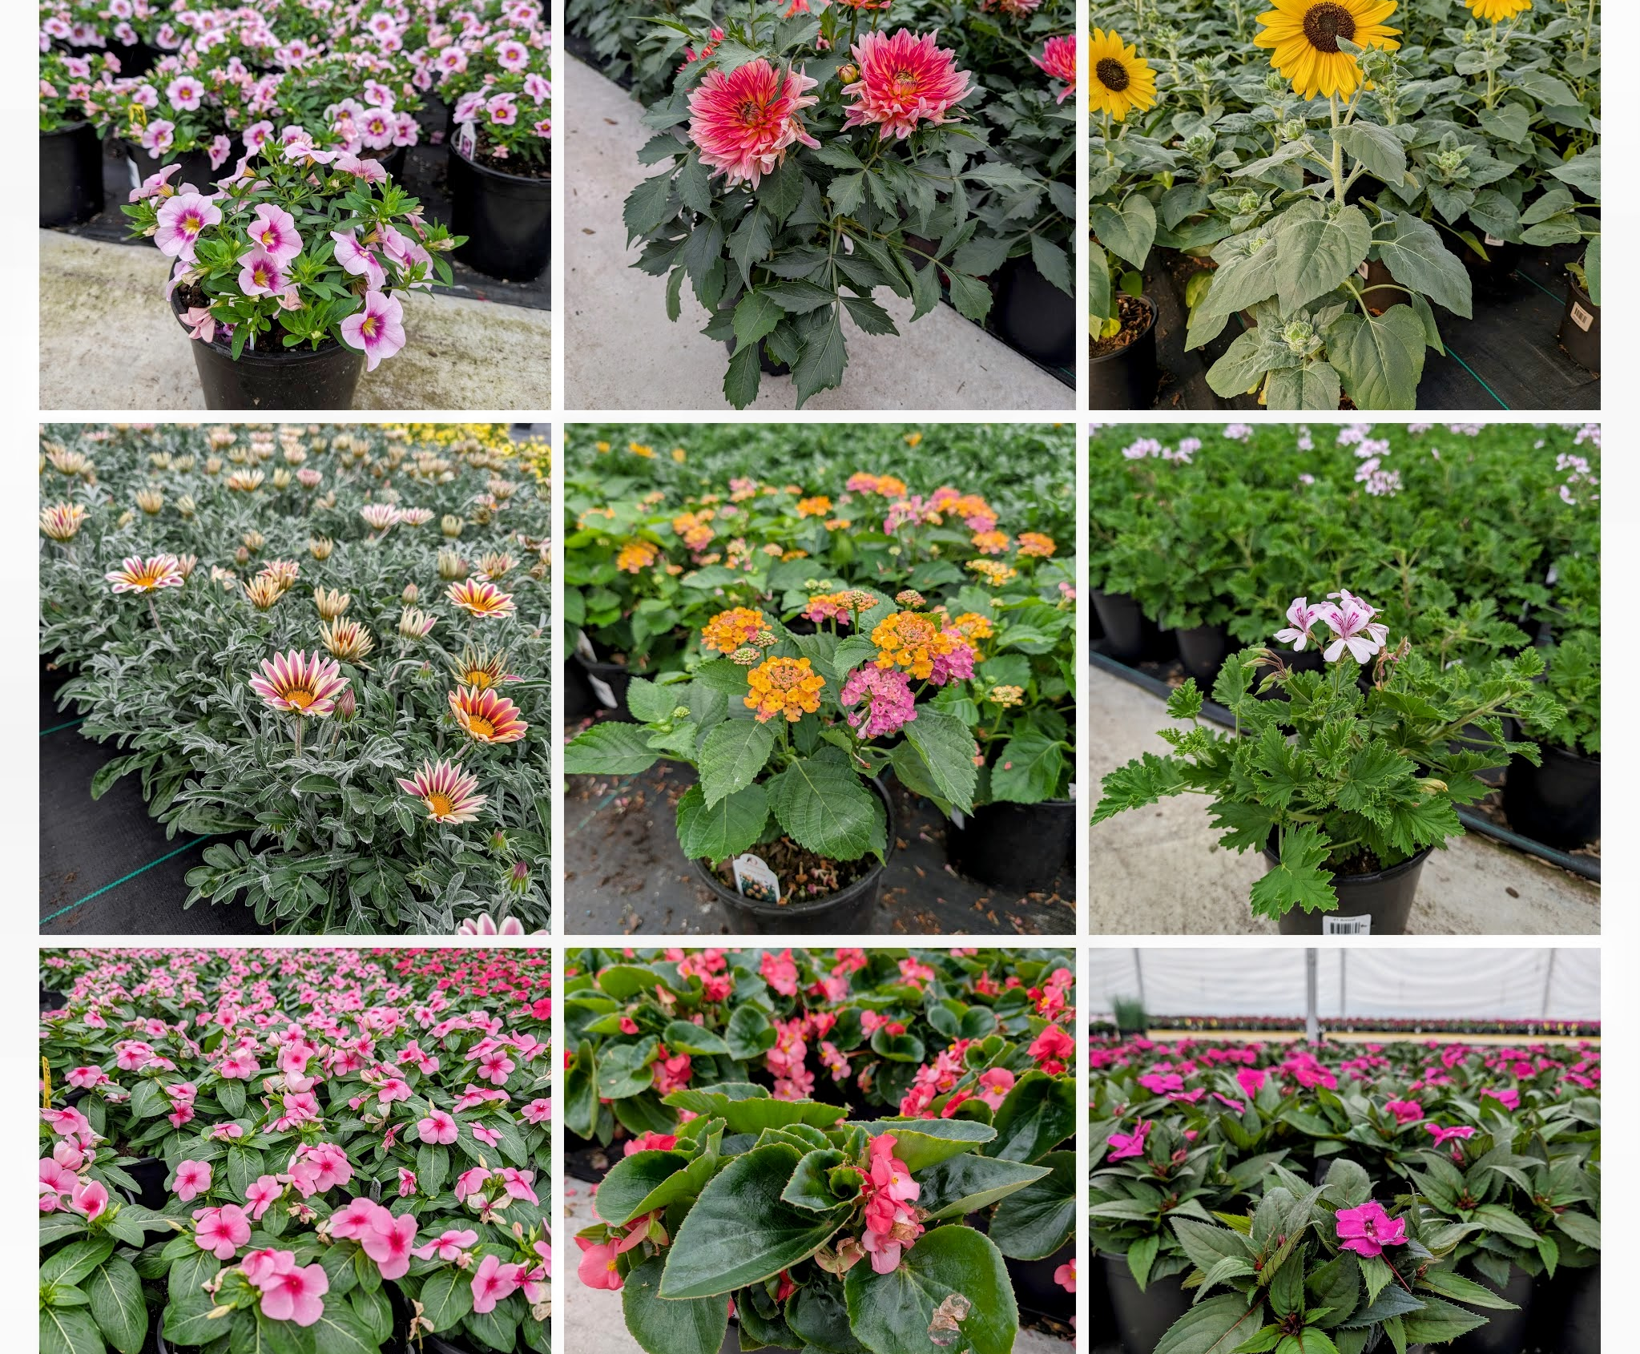
Gallon Annuals from mid Spring through the Fall!

Slide 29
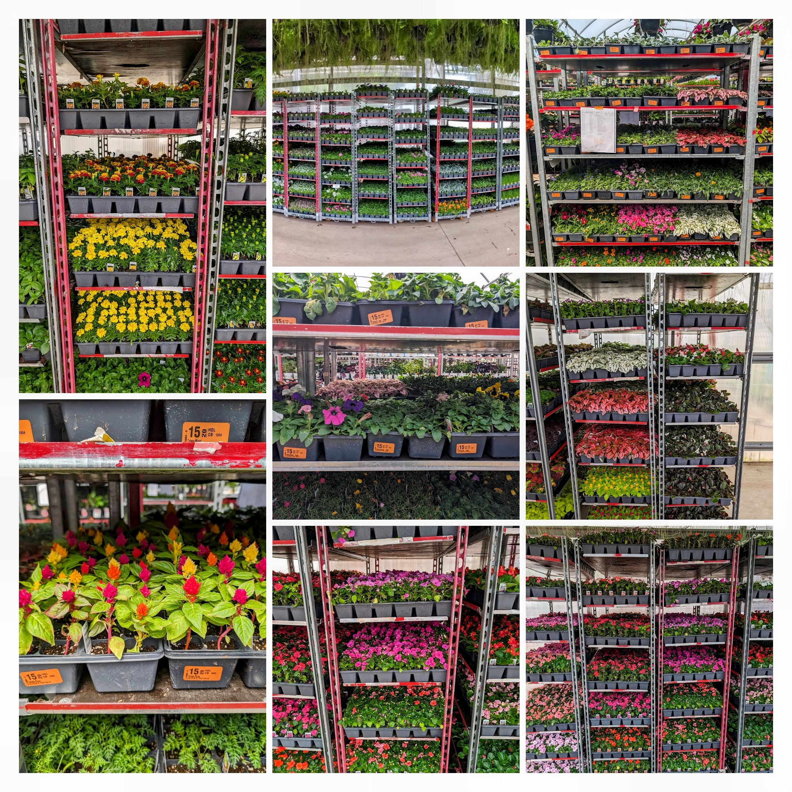
1204 ANNUAL FLAT
OVER 200 VARIETIES IN THE FLAT PROGRAM

Slide 30
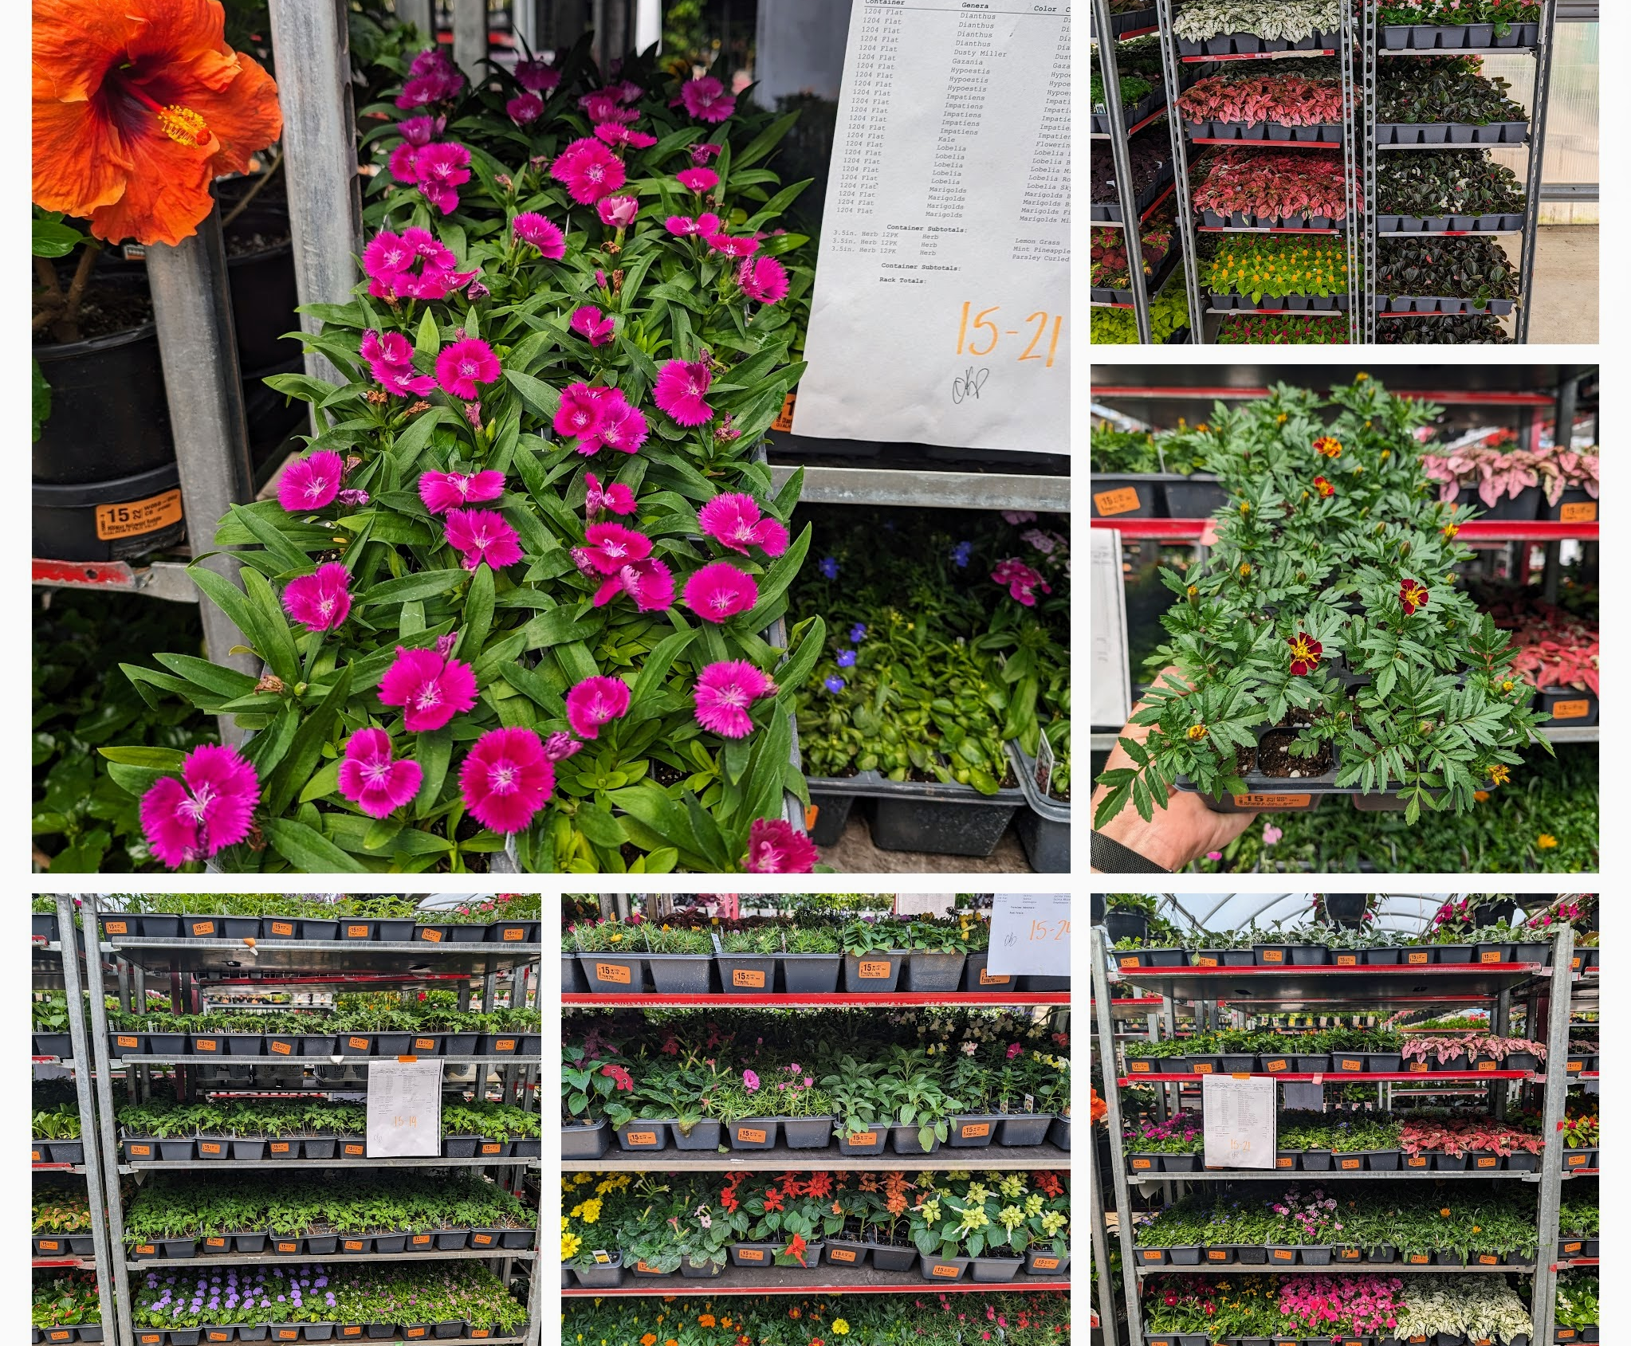
1204 Flats are one of those items that everyone looks for to fill in their landscape beds.

Slide 31
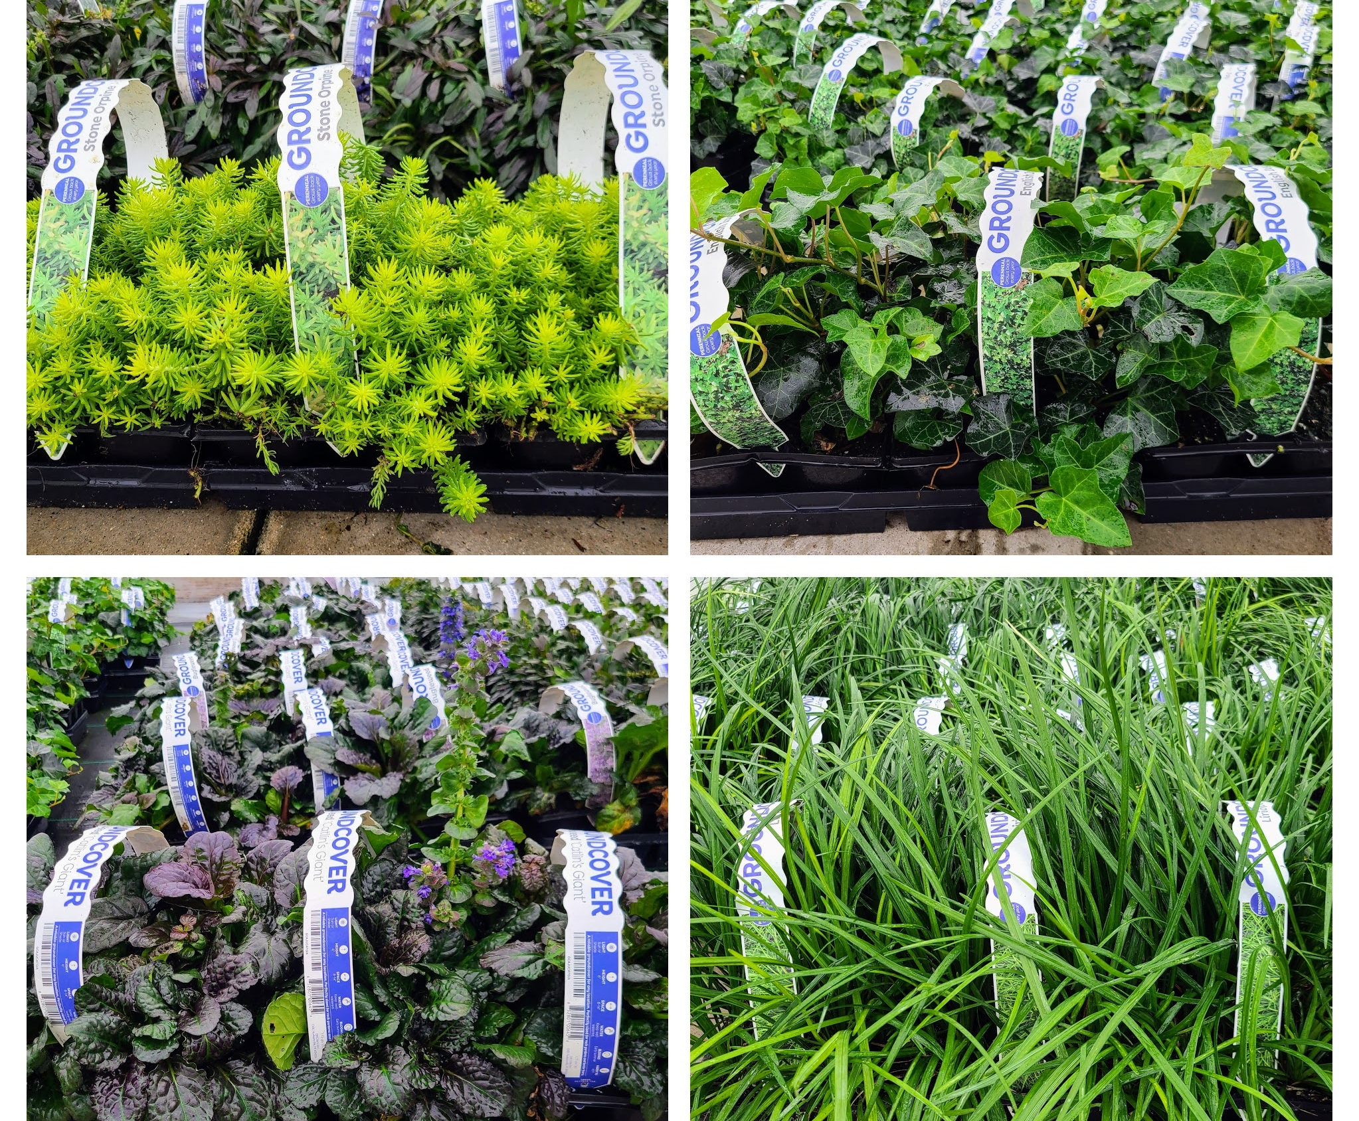
6-PACK GROUNDCOVERs

Slide 32
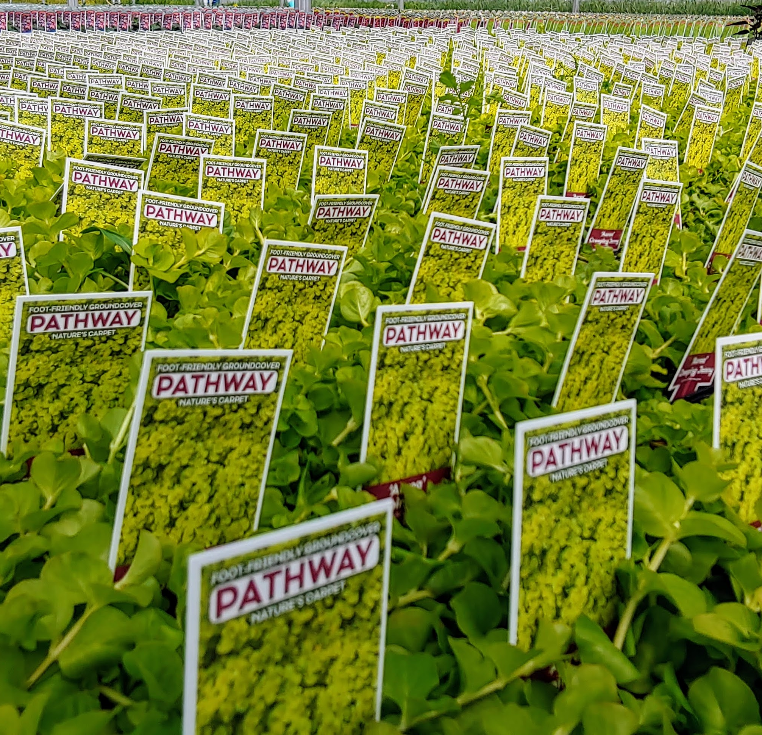
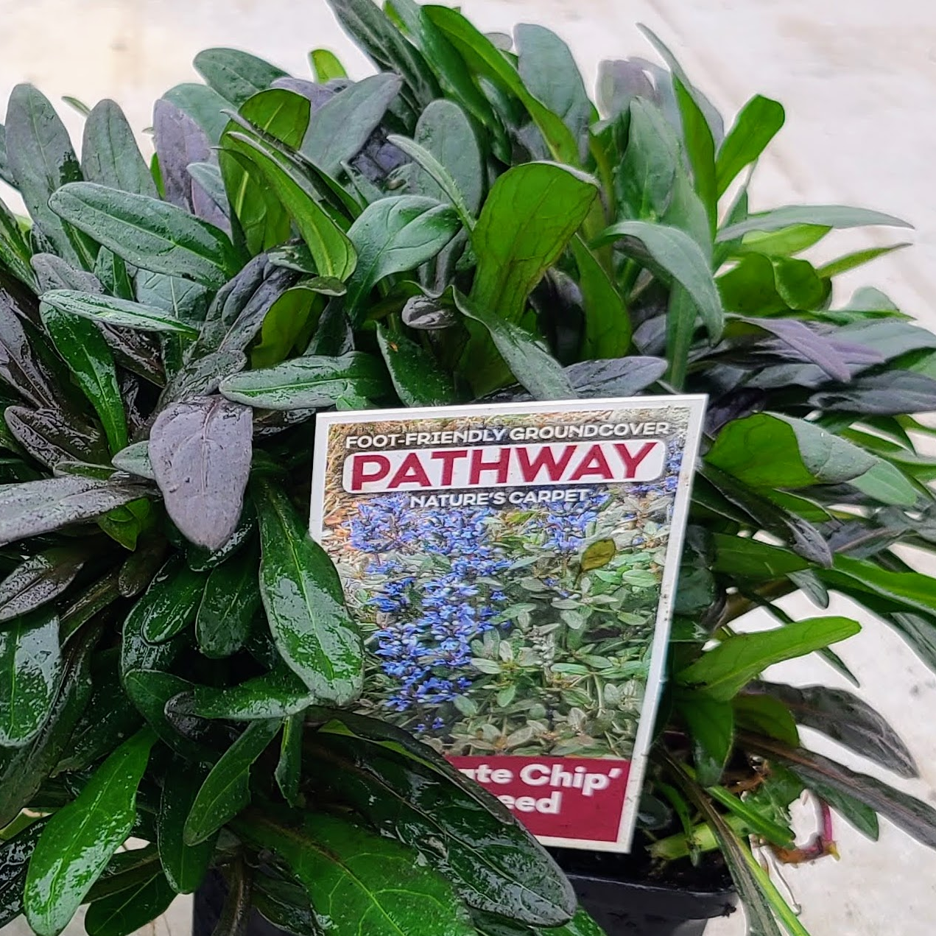
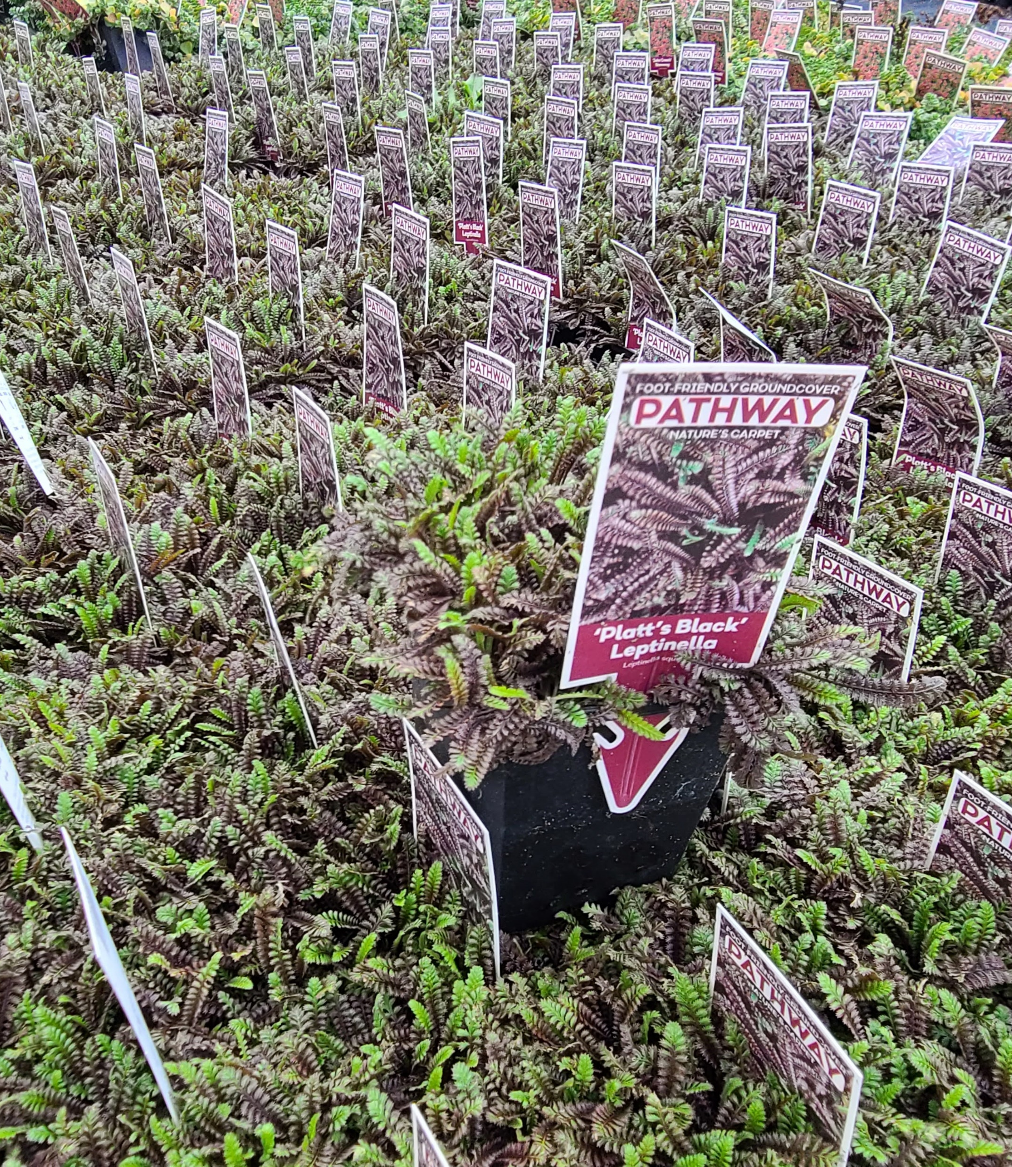
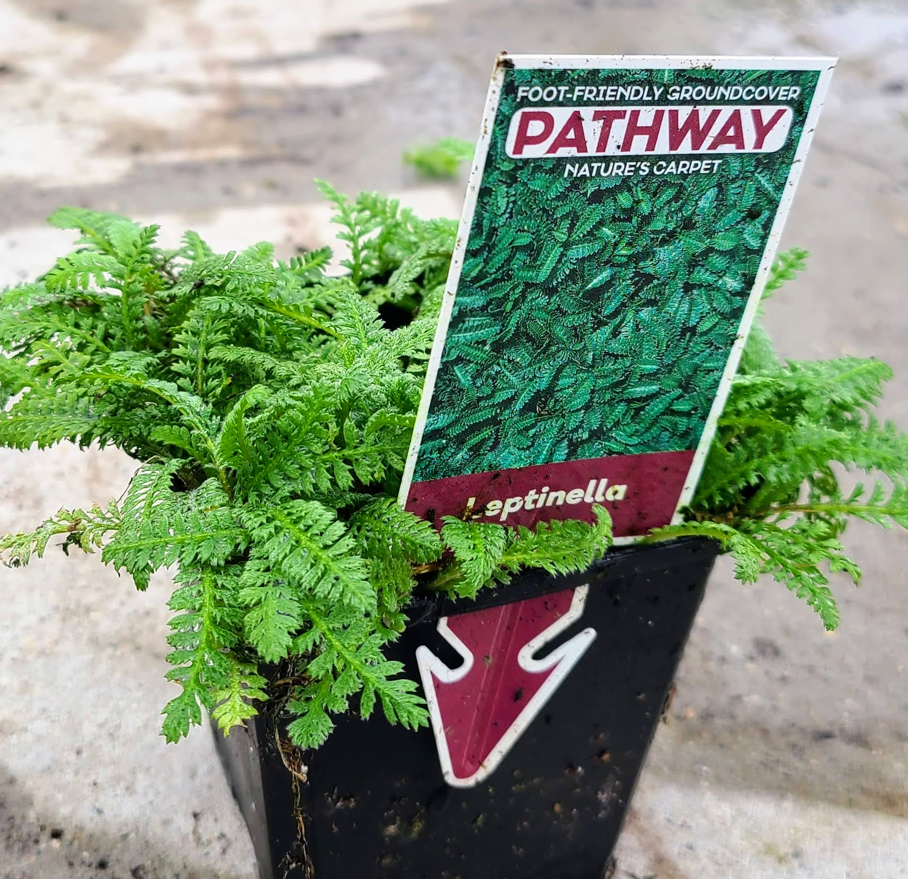
3.5” PATHWAY 12 PK TRAY

Slide 33
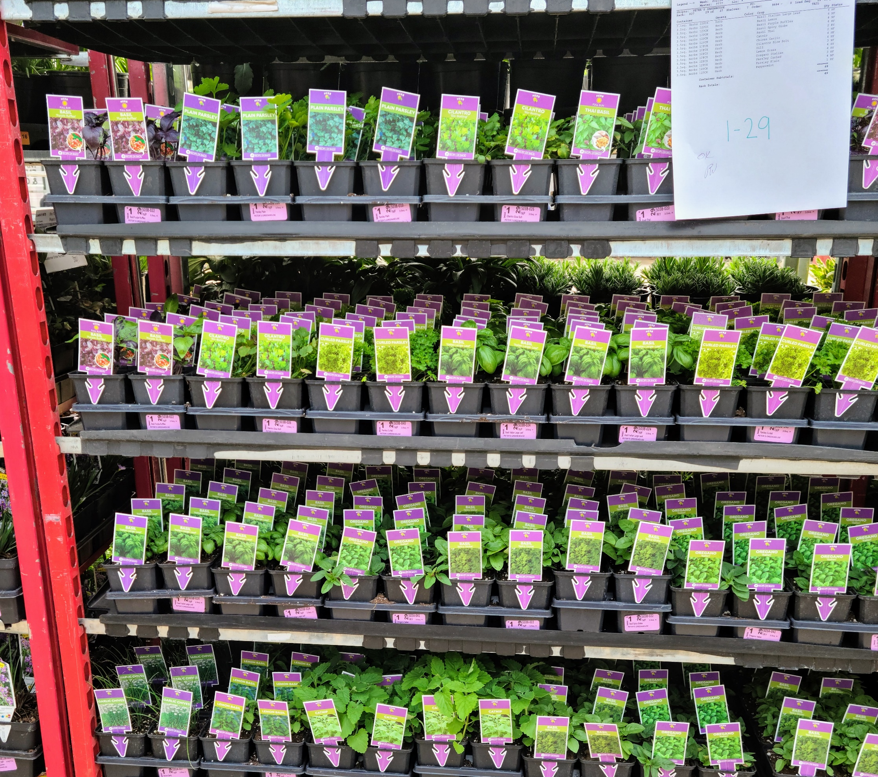
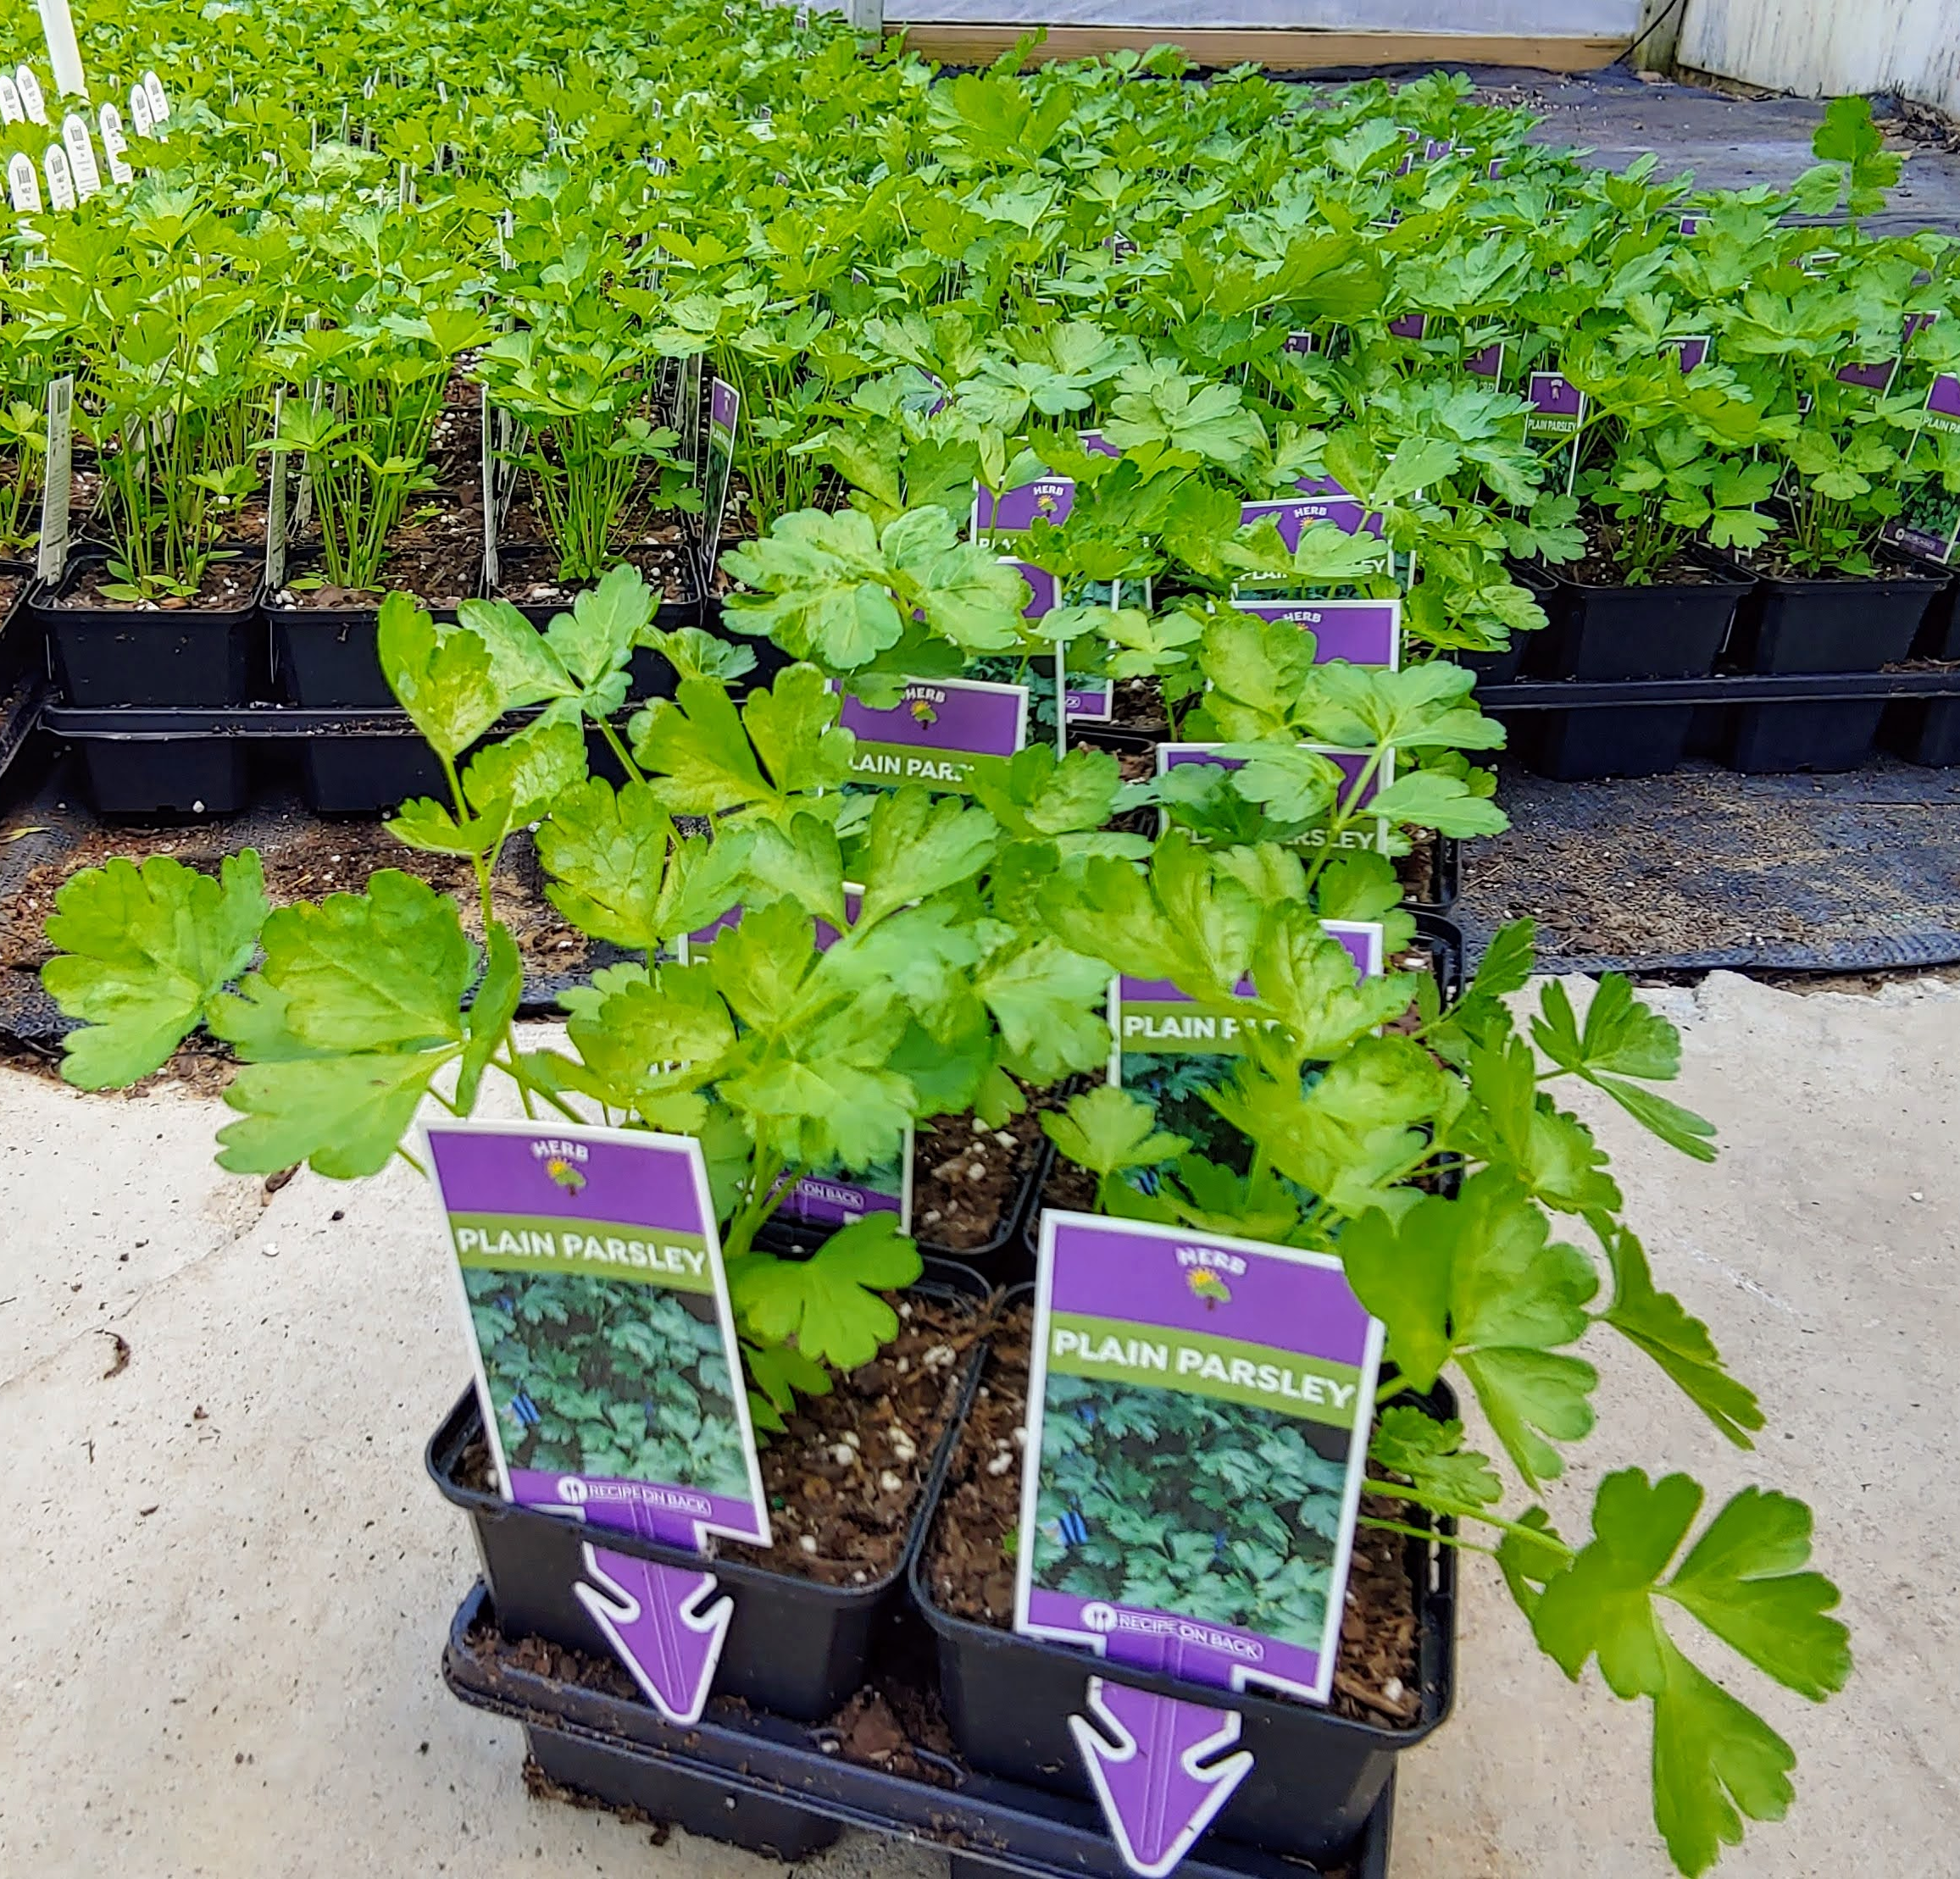
3.5” HERBS 12 PK TRAY

Slide 34
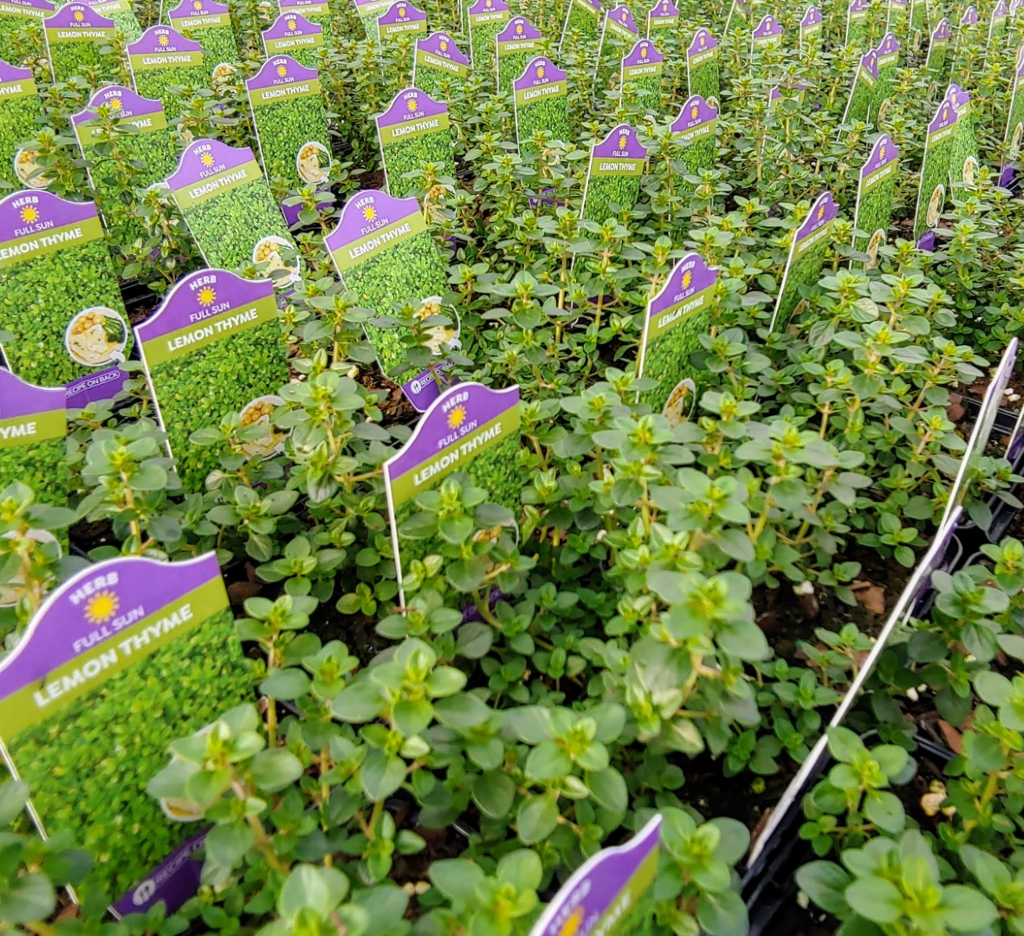
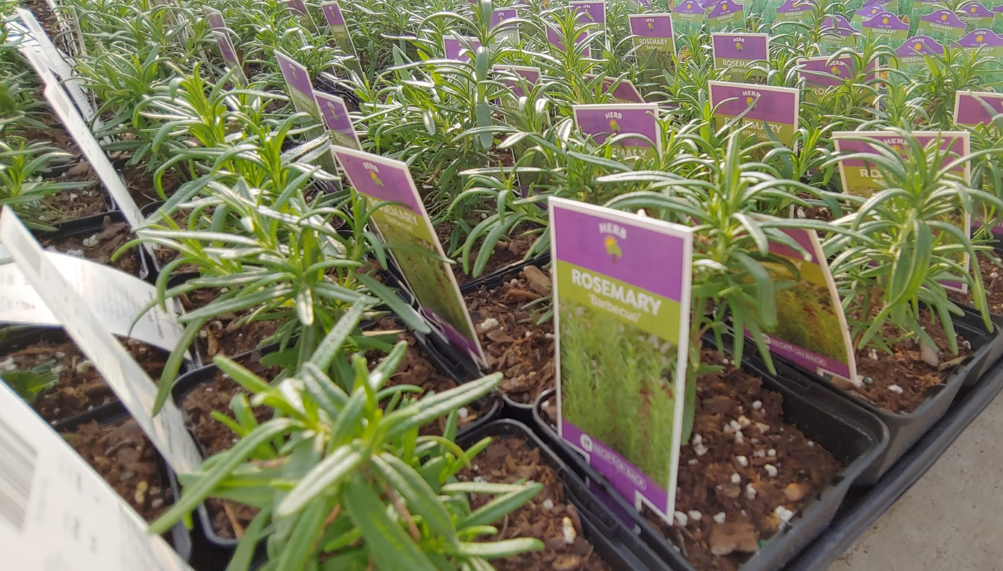
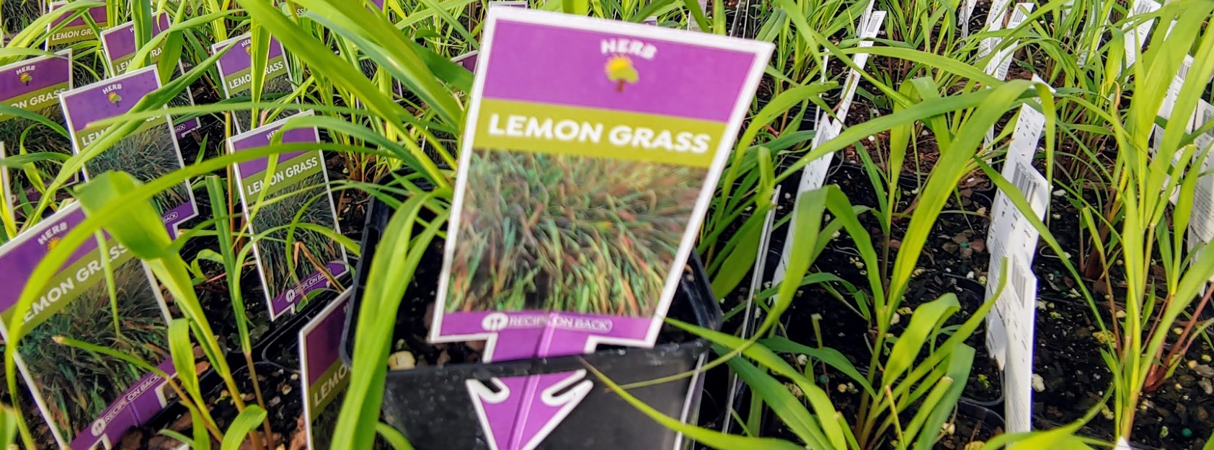

Slide 35




4in. Burpee Vegetables

Slide 36



Succulents
Bowls
Ovals
5-in pots
2-in pots

Slide 37


HOUSE PLANTS
6-IN HANGING BASKET
Forget the Florida house plants and get them local instead!

Slide 38


5-IN. 8 PK TRAY

Slide 39




Don’t Forget the Fall Decor!
8-in Mums

Slide 40

8-in Mums, a great fall item!

Slide 41


12-in. Barrel MUMS

Slide 42

12-in mum barrels

Slide 43

COMPLETE FALL ANNUAL LINE TO HELP MAKE GREAT PATIO PLANTERS!
COMES IN 4.25" POT AND IN A 6-IN GALLON POT

Slide 44


Slide 45

KEEP AN EYE ON AVAILABILITY BECAUSE YOU NEVER KNOW WHAT MAY POP UP....

Slide 46

What's Next?
How do I order?
  First Go to our website www.opelgrowers.com
  Click on the Availability as you see to the right.

Slide 47

Here is where you want to select your order form.

Slide 48

Here you begin to fill in the order form based on what you need for that order week.
Be sure to pay attention to the black headings on how the items come. Most items you order by the tray qty. There are some items like hanging baskets and mums that you are ordering eaches.

Slide 49

At the bottom of the availability, iT will tally up your racks (carts) automatically.

Slide 50


Then go and attach your order to an email and send to customerservice@opelgrowers.com
When you are done with your order click 'save as' to your computer

Slide 51
Thank you for your interest in Opel Growers. We love working with independent garden centers like yourself making your sales floor come alive with many different plants. Our goal is to help you set yourself apart from the box stores. At Opel we have fresh and new perennials and annuals for spring, summer, and fall. Our goal is to help keep your business looking fresh in all seasons!
We look forward to an opportunity in serving you and are always open to suggestions For the next best thing!
With much Thanks!
The Opel Team

Slide 52
THE END

